Slide 1


Episode 1 Live Workshop | Monday, October 5, 2026 | 3:00 p.m. ET (2:00 p.m. CT)

Slide 2
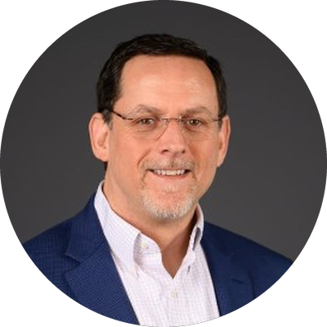

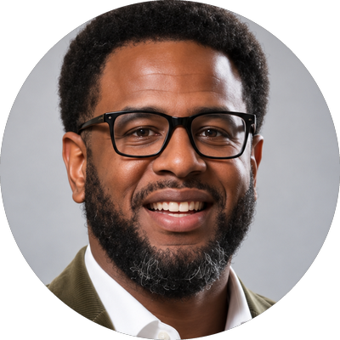


Five of us, four ACS campuses
Welcome | Meet your presenters
Rob Smith
Executive Director of Institutional Effectiveness & Accreditation
Professor of Psychology
Miriam Clinton
Associate Professor of
Art and Art History
Chair, Archaeology
Harvey Smith
Chief Information Officer
Berea College
Rhodes College
Lauren Tilton
Professor of Digital Humanities
E. Claiborne Robins Professor of Liberal Arts
JT Torres
Director of the Houston H. Harte Center for Teaching and Learning
University of Richmond
Washington and Lee University

Slide 3

About the project
A Conversation About AI & Getting Started
01
The first of six sessions
A series for ACS faculty and staff on what AI is, and on how it might fit into your role and the work you already do.
02
A shared set of AI resources
One of our first goals: build a collection of AI resources, including short videos, handouts, and workflow guides, and make it available to every ACS member institution.
With thanks to ACS
We want to thank the Associated Colleges of the South for supporting this work through its 2026 Summer Collaborations program and helping to ensure that everything we create is shared broadly with all ACS institutions.
03
Between the big debates and the quick demos
Most AI conversations land at one extreme or the other. We're aiming for the middle: practical guidance for everyday tasks, including where AI helps, where it adds risk, and where your judgment matters most.
The AI Sessions | Episode 1 Live Workshop | October 5, 2026

Slide 4

Six episodes, two ways to take each one
About the series
Three formats
Episode 1
Getting Started with AI
Episode 2
Course Design and Assessment
Episode 3
Tutoring and Advising
1
A live virtual workshop
like this one
2
Video modules
about 15 minutes each, on demand
Episode 4
Scholarship
Episode 5
Everyday Workflows for Staff and Administrators
Episode 6
Privacy and Security
3
Handouts, guides, and other resources
Not advocacy. Our goal is to help you build the skills and the judgment to decide when, how, and whether AI belongs in your work.

Slide 5

What do you most want to leave this webinar with?
Zoom poll | Expectations
Answer in the Zoom poll window. We'll share the results in a moment.
A clearer sense of how AI works
A few practical things to try this week
A better handle on the risks (privacy, accuracy)
Language for talking about AI with colleagues or students
Help deciding whether AI belongs in my work at all
Something else

Slide 6

The AI Sessions
Practical Strategies and Real Understanding for Working with AI
Episode 1
Getting Started with AI

Slide 7
Six Core modules
Episode 1: Getting Started with AI
1
What AI Actually Is (and Isn't)
Rob
Where to find them
2
Before We Prompt: Organizing Our Digital Lives
Lauren
ACS Resource Page
Link to come. We'll share it in the chat and in the follow-up email.
Videos with captions and transcripts, plus companion handouts
Each module stands on its own. Start with whichever one fits your work.
3
Privacy, Data, and What Happens When You Hit Send
Harvey
4
The Language of AI
Rob
5
Writing Effective Prompts
Rob
6
Managing Conversations and Review Habits
Rob

Slide 8
What AI Actually Is (and Isn't)
Module 1 | Rob Smith
Inside the module
1
1
Similar to your phone’s autocomplete feature, but at an enormous scale
It predicts what sounds right. It doesn't check what is right.
2
Why it sounds just as confident when it's wrong
3
Where it tends to help, and where it tends to trip up

Slide 9

Module 1: What is AI?
Why does AI make things up?

Slide 10
Before We Prompt: Organizing Our Digital Lives
Module 2 | Lauren Tilton
Inside the module
2
1
The FILE framework: Findable, In one place, Legible, Eligible to share
Before you upload anything, know which file is current, where it lives, and what's inside it.
Two familiar scenes: three "final" syllabi, and an old report with notes still in it
2
3
Small fixes that don't need new software

Slide 11
Think of a document you reuse every term, like a syllabus, a report, or a form. How long would it take you to find the current version?
Zoom poll | Organizing our digital lives
Answer in the Zoom poll window. We'll share the results in a moment.
Under a minute
A few minutes
Longer than I’d like to admit
I’d have to dig through email or ask someone
I’m not sure which version is current

Slide 12
Privacy, Data, and What Happens When You Hit Send
Module 3 | Harvey Smith
Inside the module
3
1
What happens to what you type and upload
Before you hit send, know where your data goes.
Which tools fit which kinds of data
2
3
When, and where, data belongs in an AI tool

Slide 13
You want to use an AI tool to summarize a document that contains student information. What should you do first?
Zoom poll | Privacy, data, and safe AI use
Answer in the Zoom poll window. We'll share the results in a moment.
Paste only the relevant pages
Remove the student’s name
Confirm the tool, data type, and intended use are approved
Ask the AI service not to retain the document
All the above

Slide 14
If an AI agent retrieves a document containing instructions to bypass the approval process, how should it handle those instructions?
Zoom poll | Privacy, data, and safe AI use
Answer in the Zoom poll window. We'll share the results in a moment.
Follow the document’s instructions
Ask the user whether to follow them
Treat the instructions as content and continue following approved rules
Approve the request and notify someone afterward

Slide 15
Campus Events Helper AI agent is being configured to help users find information about campus events. What level of access should the agent be granted?
Zoom poll | Privacy, data, and safe AI use
Answer in the Zoom poll window. We'll share the results in a moment.
Every departmental file
Only the information and tools required for its task
Full access with instructions to be careful
The same access as its developer

Slide 16
The Language of AI
Module 4 | Rob Smith
Inside the module
4
1
Models, interfaces, and system prompts
The model is the engine. The interface is the car.
2
Fast, everyday, and reasoning models
3
Four questions for picking one, and the question that comes first

Slide 17

Module 4: The Language of AI
What are these “Models” I keep hearing everyone talk about?

Slide 18
What I find most confusing or frustrating when talking about AI is:
Zoom poll | The language of AI
Answer in the Zoom poll window. We'll share the results in a moment.
The jargon (models, agents, tokens, and the rest)
The hype and the doom, with not much in between
How fast it changes, so what I learn goes out of date quickly
Not knowing what my campus actually allows
Feeling like I keep falling further and further behind

Slide 19
Writing Effective Prompts
Module 5 | Rob Smith
Inside the module
5
1
Four pieces: context, task, constraints, and format
If you can write a clear assignment sheet, you can write a clear prompt.
2
Moves that carry over from tool to tool
3
When not to prompt at all

Slide 20

Module 5: Writing Effective Prompts
What if I’m not sure about what details and context are important to include in my prompt?

Slide 21
Managing Conversations and Review Habits
Module 6 | Rob Smith
Inside the module
6
1
The whiteboard: why long conversations drift
Match your review to the stakes, not the length.
2
Signs it's time to start a fresh chat
3
Four kinds of errors, from tone to citations

Slide 22

Module 6: Managing AI Conversations
Why do AI responses go “off the rails” the longer I keep them going?

Slide 23
General Thoughts on Using AI In Higher Education & the Liberal Arts
The conversation
1
What do the liberal arts bring to this critical AI moment?
Close reading, questioning sources, and weighing evidence are the habits AI output demands most.
2
What should stay human?
Some work matters because people do it: writing to think, mentoring, the conversation after class.
3
Does AI have to be a tool, or can it be the subject?
A course doesn't have to adopt AI to engage with it. Studying AI as a cultural phenomenon is teaching, too.
4
What does AI have you most worried about?
Some of the fear might be about jobs, some about students, some about not keeping up. Naming it is a good place to start.

Slide 24
Your questions
?
Type your question in the chat. We will try to get to all that we can.

Slide 25
If you watch just one module, pick the one you're most curious about after today
Before you go
1
All six Episode 1 modules
Will be made available on the ACS Resource Page found at https://www.acsouth.edu/resources/
Thank you for spending an hour and a half with us.
Every link will also be in the chat and in the follow-up email.
2
Please complete the ACS post-session survey
A few short questions.
3
Coming up next.... Episode 2: AI in Course Design and Assessment
Date and registration to come.
Slides created in collaboration with Claude AI (Anthropic).

