Slide 1

Leading Through Difficult Times
Kimberly A. Griffin
Cornell Verdeja-Woodson

Slide 2
Overview
Brief intros
The current landscape
“How we lead” during this time
Honoring “who we are”
A case study
Questions and reflections

Slide 3
Introductions
Hello!

Slide 4
Who are we?
Why do we lead?
How do we lead?

Slide 5
The Current Landscape
What. A. Time.

Slide 6
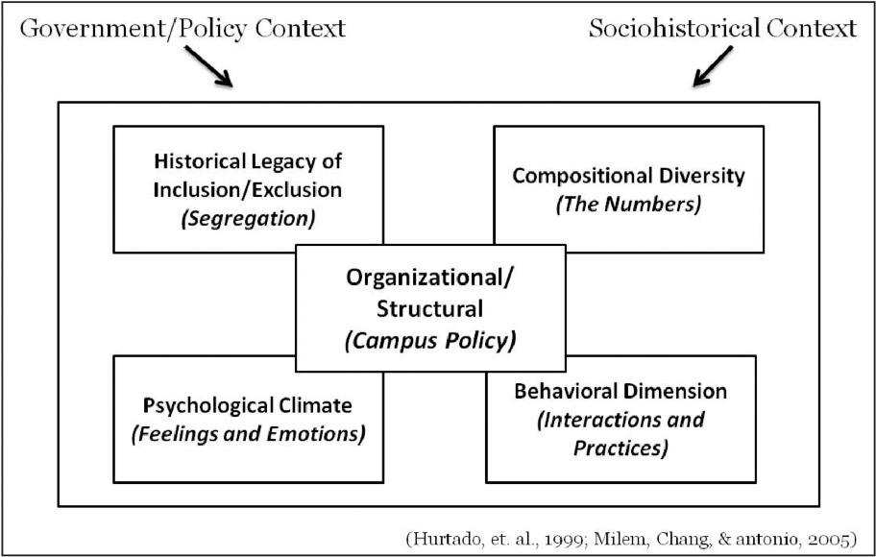
The Current Landscape

Slide 7
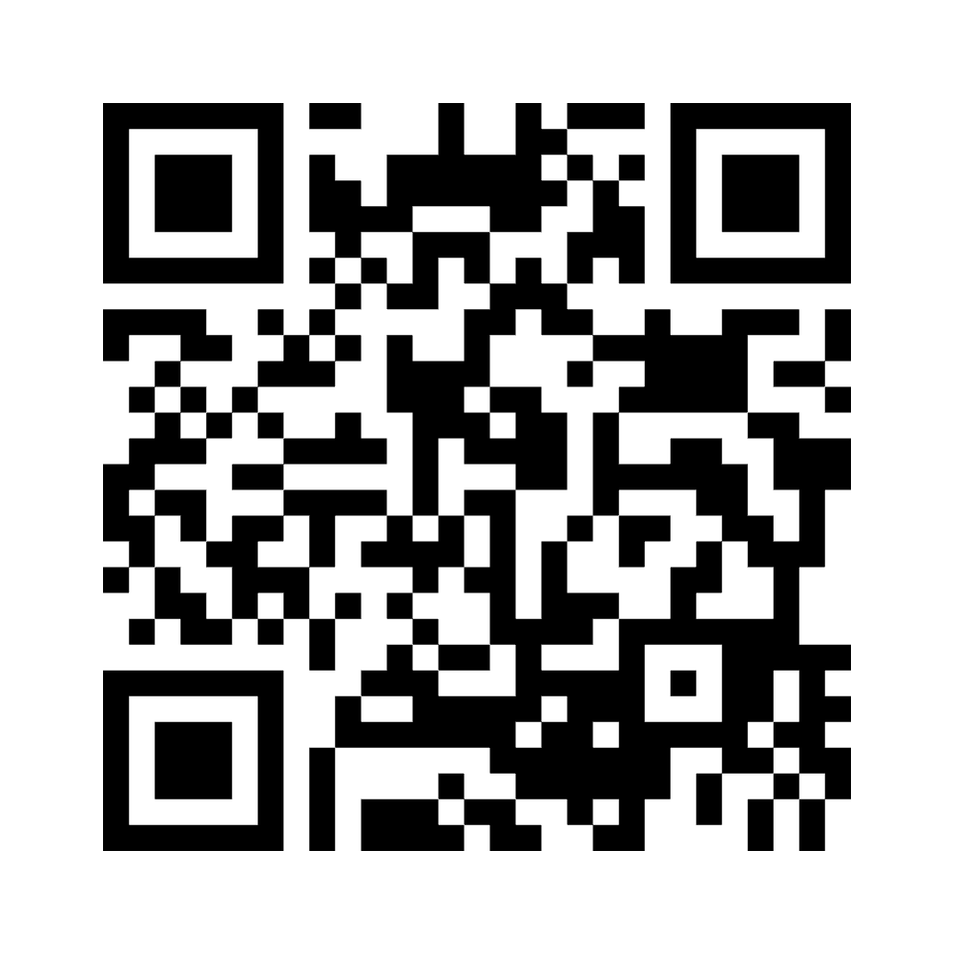
Leading in This Landscape
How would you describe the challenges of leading in this landscape over the past few years?
What feelings did you experience as a leader as you navigated this landscape?

Slide 8
How We Lead
Effective leadership that meets the moment

Slide 9
Coming to terms with…
vs
The actual role of a leader
What we thought the role of a leader would be

Slide 10
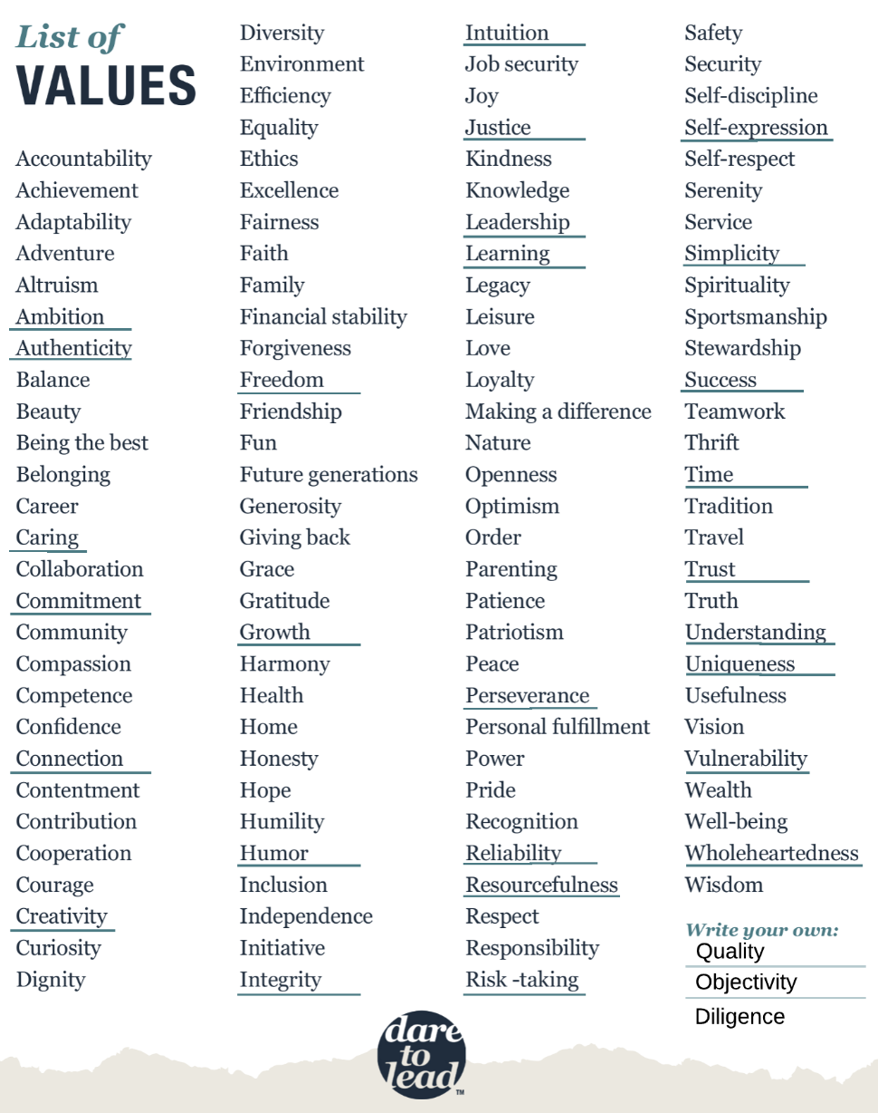
Leadership
Values
Notes:
Choose 3.
What do they mean
Pick one - how did it inform your life as a faculty member - how could it inform your leadership (the why or how) moving forward
Group of 4 and share. Maybe report out something that they learned

Slide 11
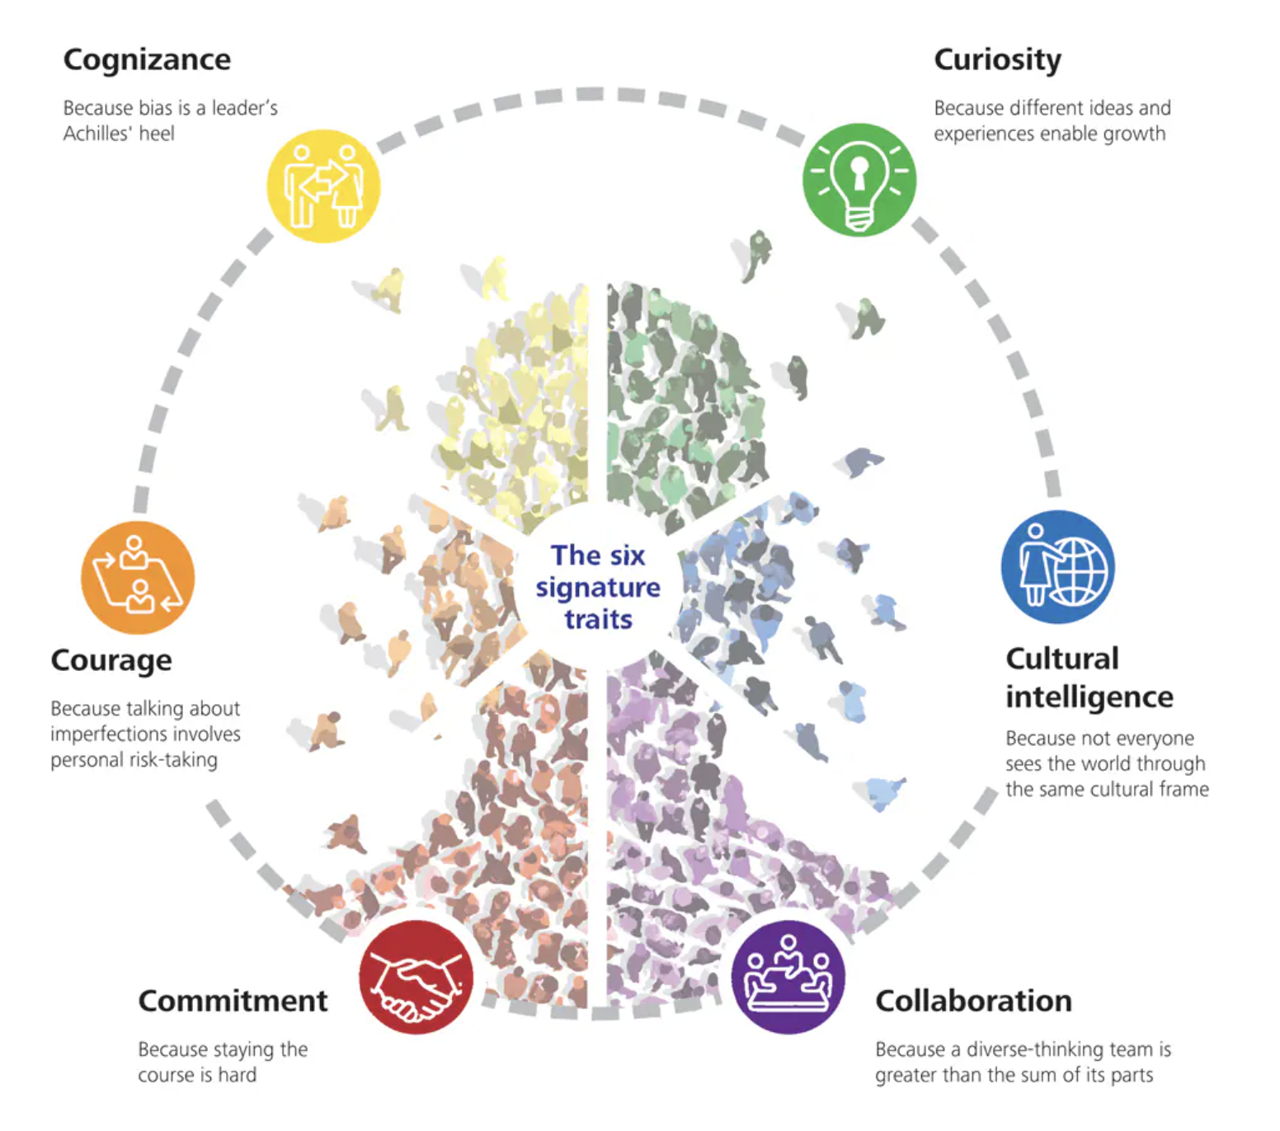
Inclusive Leadership

Slide 12
Human Connection & Trust
Honest vulnerability
  Personal experiences
  Shared experiences
Asking for help
  Acknowledging what you do and don’t know
  Locus of control
Transparency
  Sharing information vs protecting people

Slide 13
Communication
Understand what your team(s) might be thinking and feeling.
Share information regularly and through different mediums.
Create channels for feedback.
Express your vision for the future steeped in shared values and purpose.

Slide 14
Communication
Understand what your team(s) might be thinking and feeling.
What are people are…
Thinking (eg. I’m going to be fired, my role will change, how we do our work will change.).
Feeling (eg. I feel overwhelmed, everything is going wrong, I feel unsupported.).
Experiencing through their identities and at the intersection of those identities .

Slide 15
Communication
Share information regularly and through different mediums
Repetition
Different mediums (email, video, zoom, in-person)
Bright spots in a sea of negativity
Reminder of past triumphs
Addressing unique needs and concerns to different groups

Slide 16
Communication
Create channels for feedback
Equip frontline managers (VPs, Directors, ADs)
Connect with employees
  Focus groups
  Skip level conversations
  In the hallways, parking lots
Review it and take action

Slide 17
Communication
Express your vision for the future steeped in shared values and purpose
Help employees understand the following:
  What is the vision?
  Why are we going in this direction?
  How are we going to do it?
  When will we start or complete this work?

Slide 18
Change Management
Current
State
Desired
State

Slide 19

Change Management

Slide 20
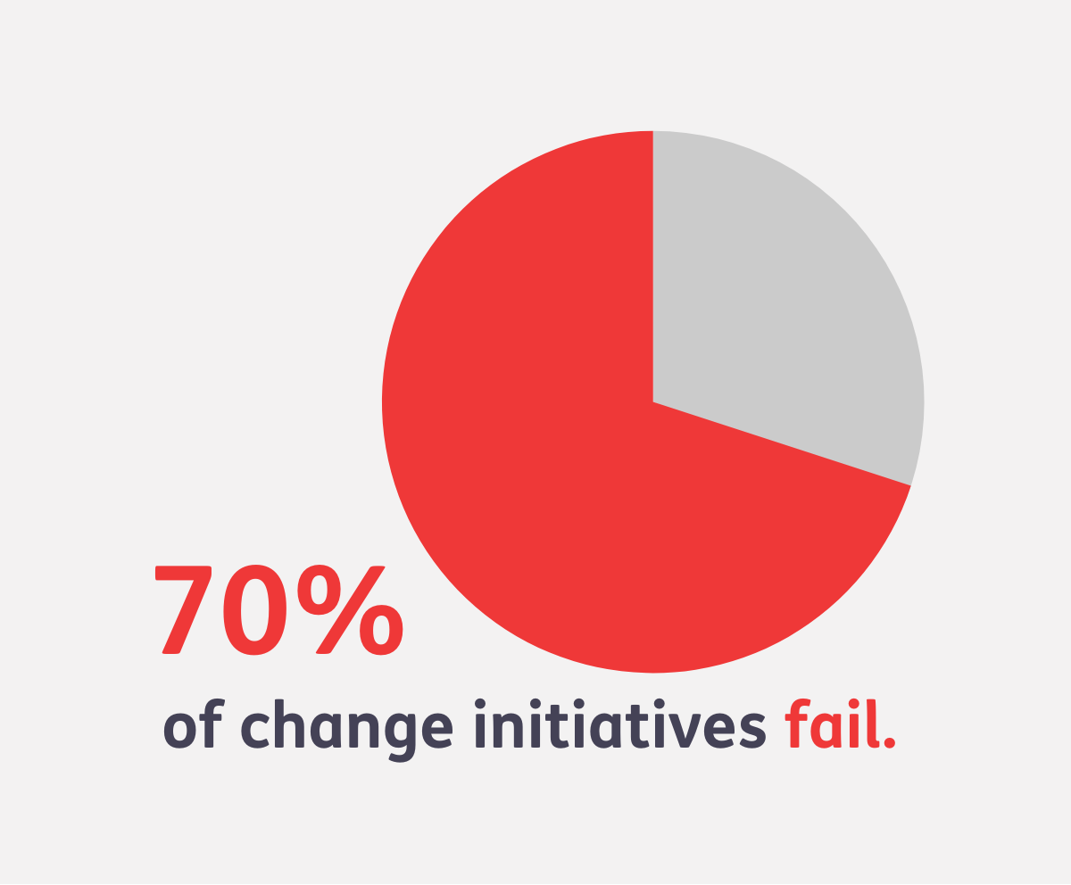
Change Management
Status quo bias
Loss aversion
Organizational politics
Poorly defined objectives and metrics
Unrealistic goals and timeline
Unmotivated employees and people leaders
Kotter, 1995; Tung, 2014

Slide 21
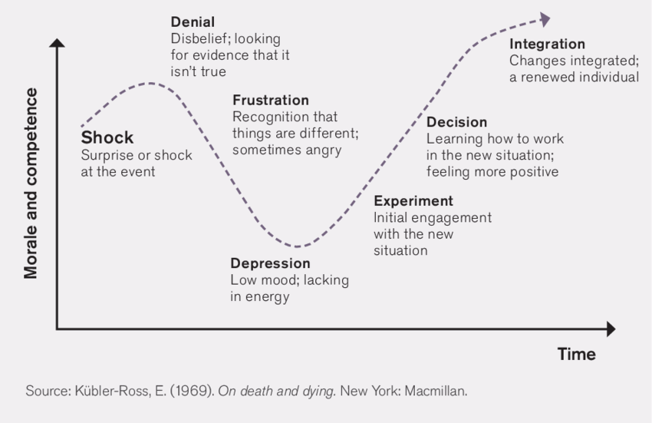

Slide 22
Distinguishing Between…
vs
What are reasonable expectations?
What are unrealistic expectations?

Slide 23
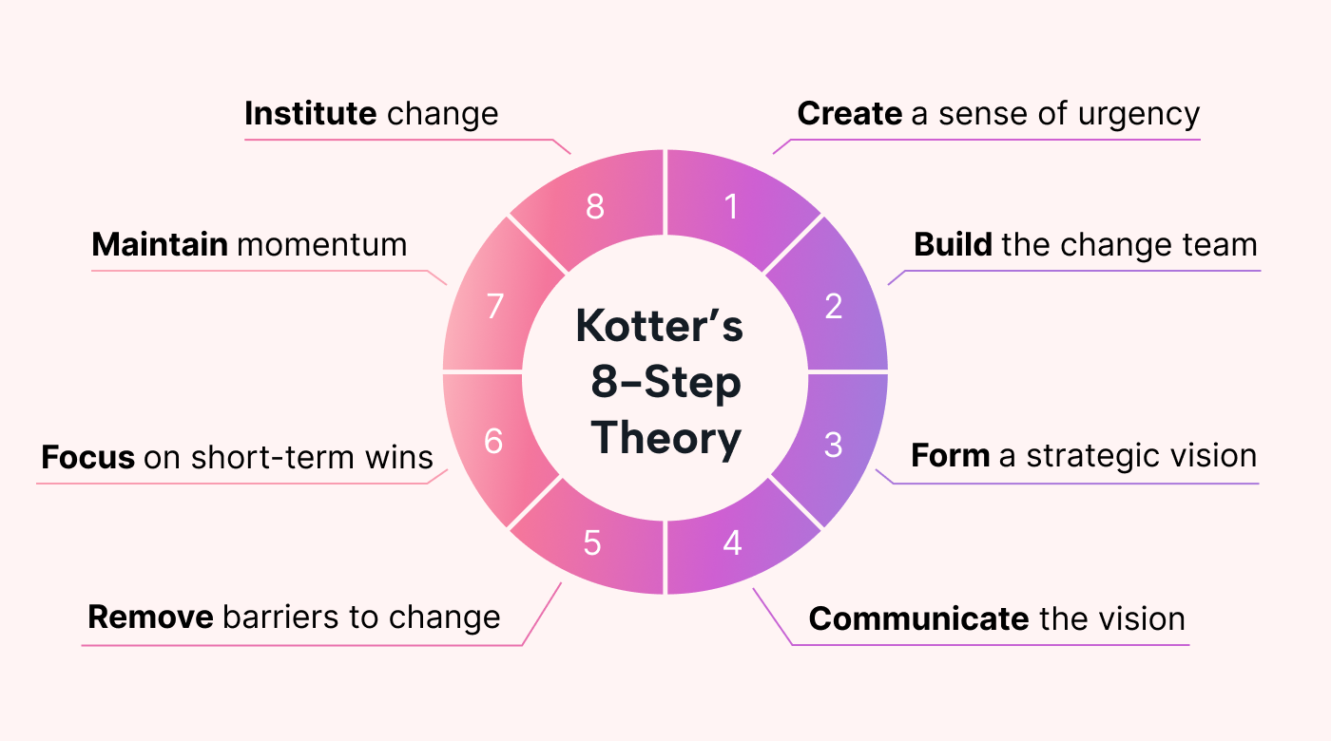
Change Management

Slide 24
Honoring Who We Are
Leadership and Staying Whole

Slide 25
Three Words to Describe
How you lead when you’re at your best
How you lead when you’re at your worst

Slide 26
4 Lessons
The real self care
Define my scope of influence
Accept polarities
Problem solving as shared

Slide 27
Self Care
MOVE
RESTORE
PLAY
SEEK SUPPORT
REFLECT

Slide 28
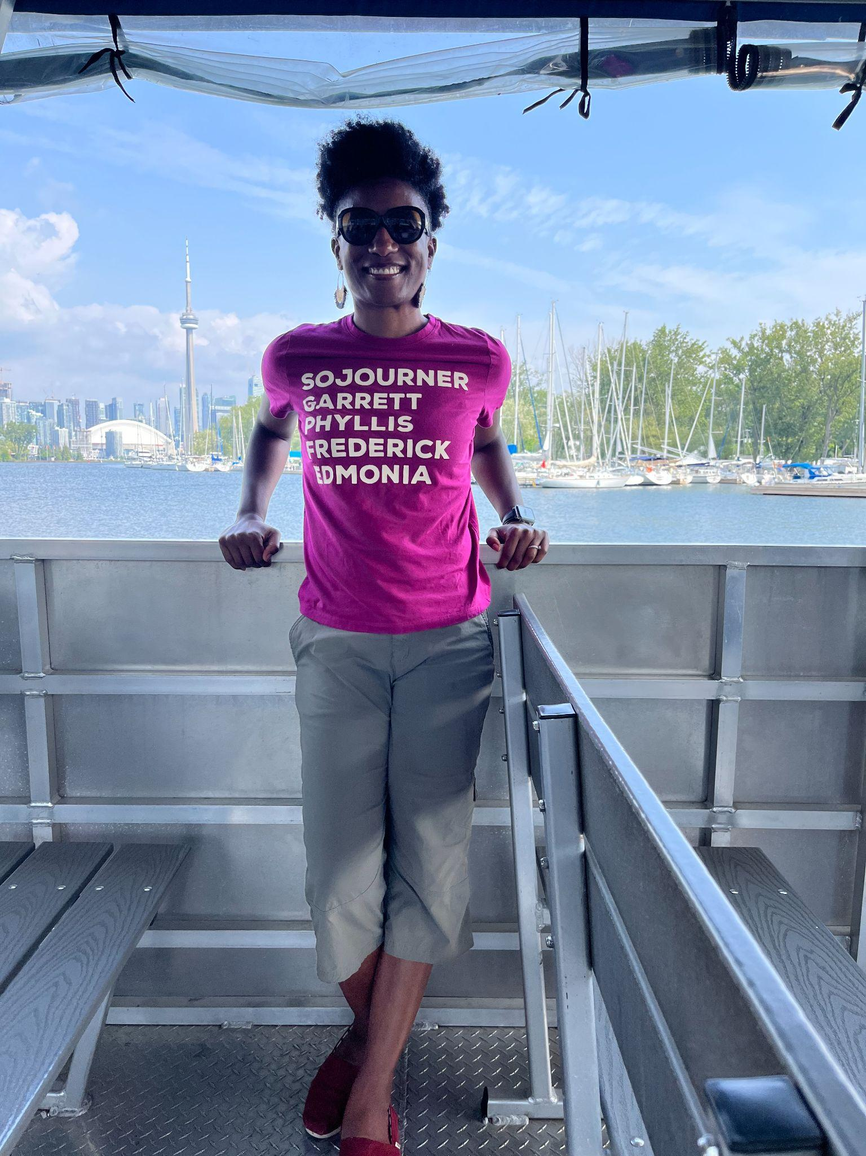
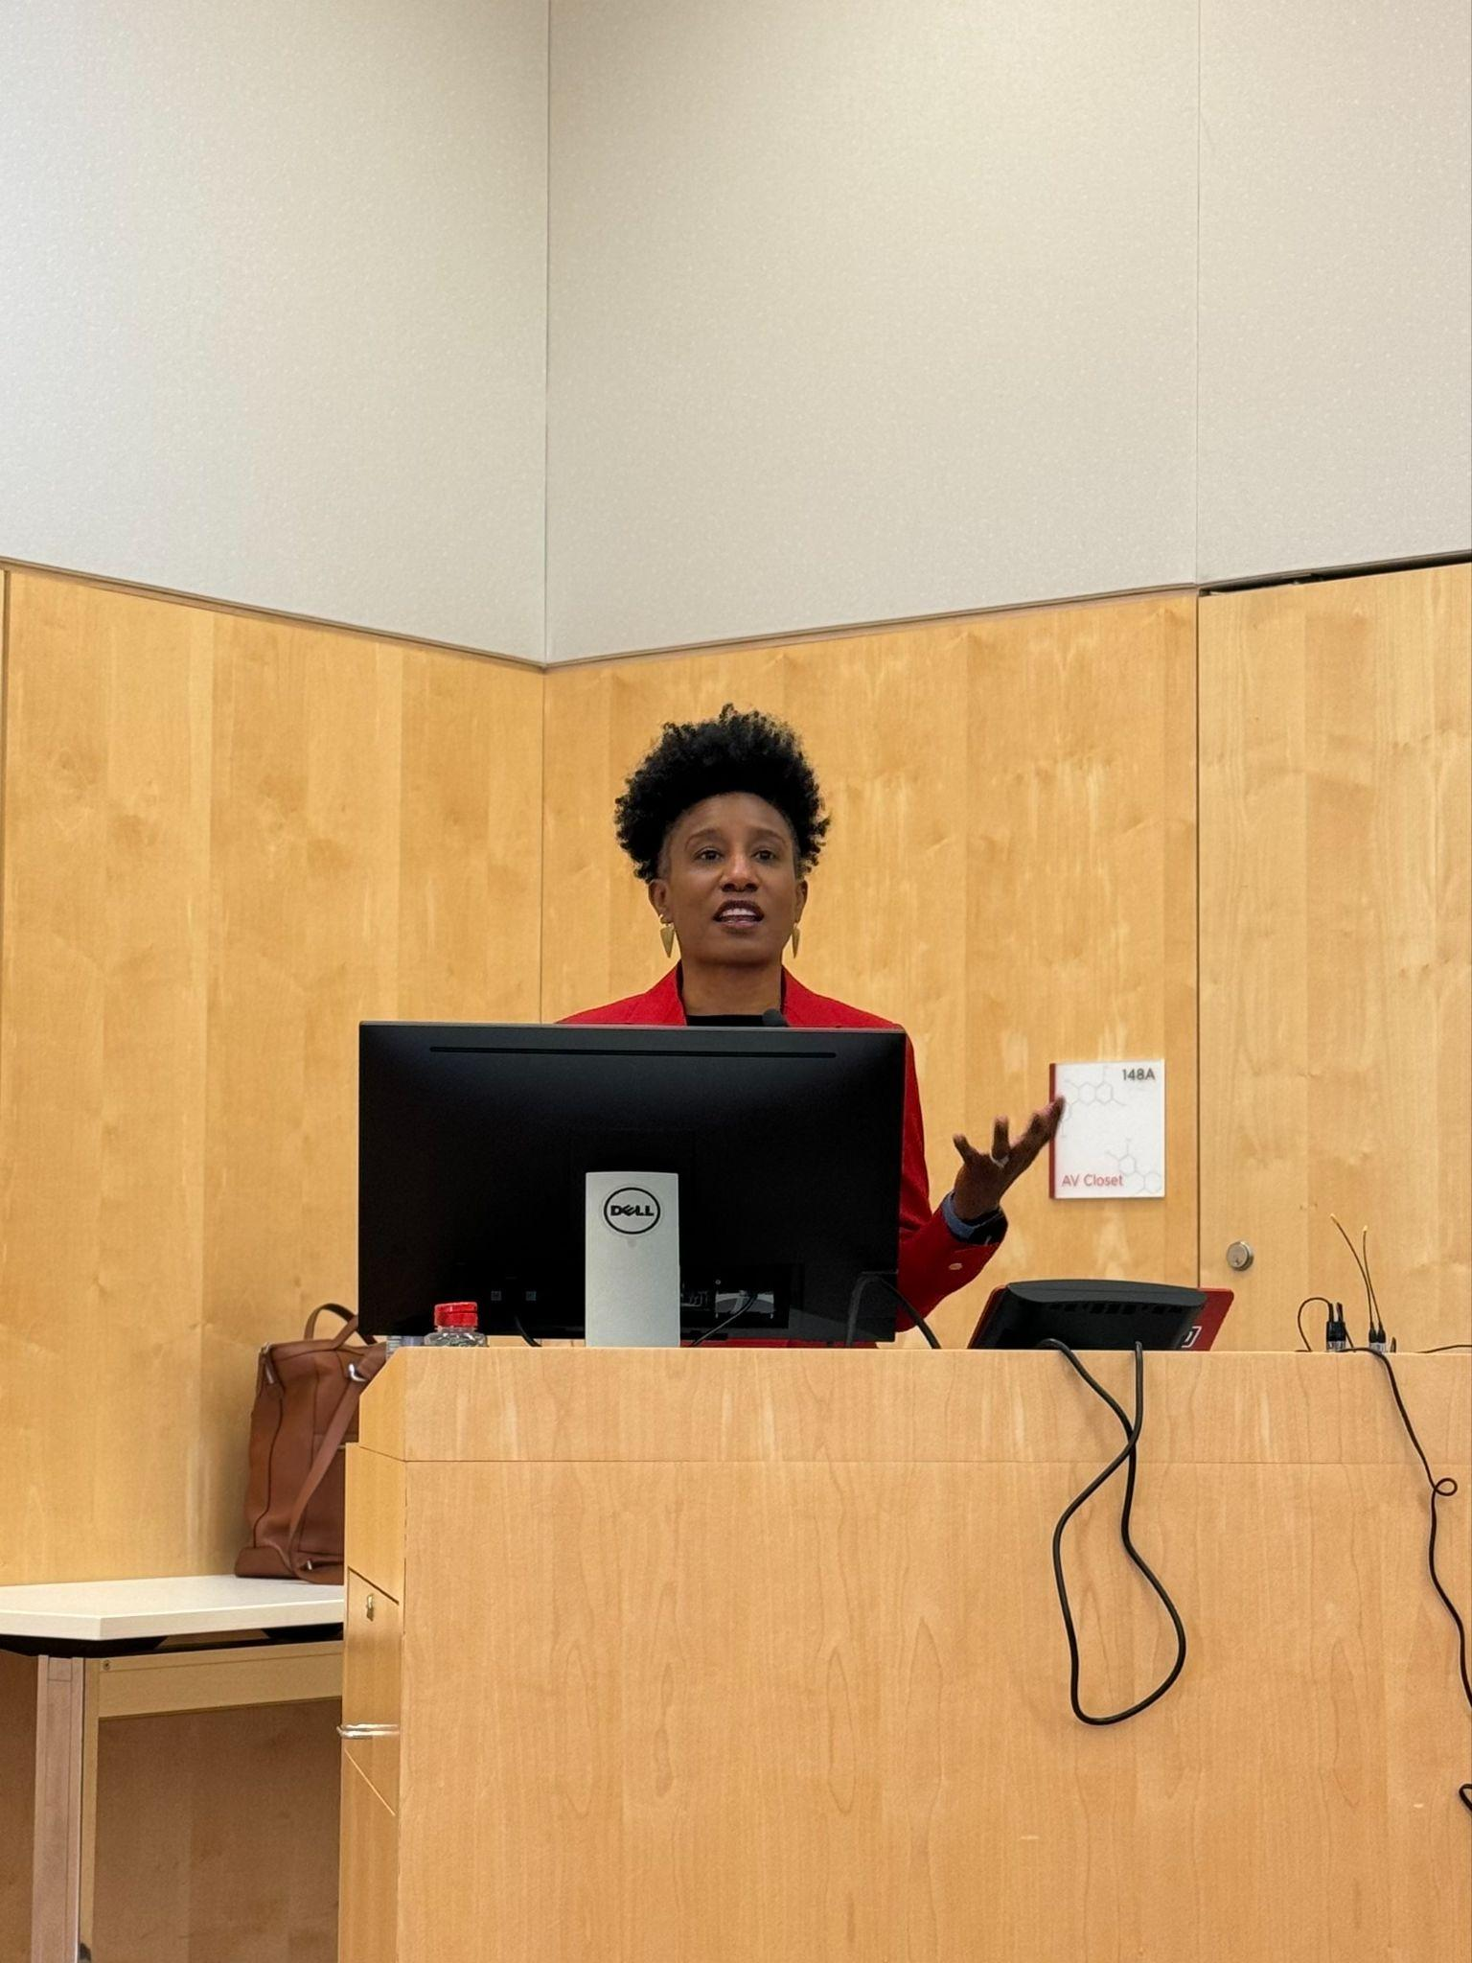
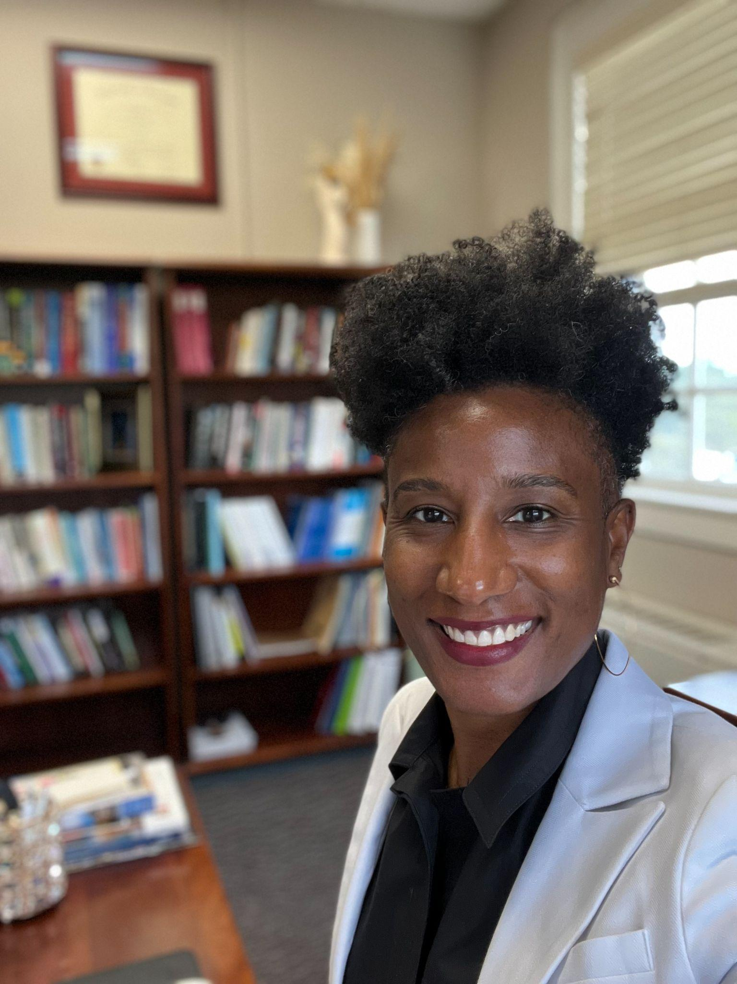
Define Scope of Influence

Slide 29
Accept Polarities
EdTerps,
I struggle to find the words to capture just how complex, challenging, and in many ways, heartbreaking the world feels right now. Across our state, our nation, and around the world, there is unrest, injustice and violence. Many of us are trying to manage big emotions - fear, anger, and sadness - as we navigate the already difficult pace and demands of the end of the academic year.
In the midst of these challenges, the work we are doing to build a community of care and transform education for good keeps me grounded and gives me hope for the future. Our shared commitments to improving schools and society tie us together, and can be an important foundation for connection. I hope that we can continue to hold space for each other and support each other, especially in these challenging times.
This is SO hard. I am not sure what to do.
I am holding on to hope for a better tomorrow.

Slide 30
Shared Problem Solving
I have a big problem to solve
There’s a problem - you need to do your part to solve it
We have a problem. We all are key to solving it. Let’s work together

Slide 31
Bringing the Pieces Together
A Case Study

Slide 32
The provost just announced your institution is in financial trouble, and needs to cut $3M from the budget. All academic units are expected to help and cut their respective budgets accordingly. In your unit, the budget is largely salaries, and there is little cushion or wiggle room.

Slide 33
Discuss
How will you begin to orient yourself to this moment? What tools can you use to help navigate this situation?
How would you be intentional about taking care of yourself and staying motivated?

Slide 34
Questions and Reflections

Slide 35
Leading from our values
A key indicator of why you are and what is important to you
A few principles that guide your life, decisions, interests, and actions
They are consistent and enduring across roles and contexts
Often connected to your “why”
Achievement
Authenticity
Community

Slide 36
Considering your values
Authenticity
Achievement
Adventure
Authority
Autonomy
Balance
Beauty
Boldness
Compassion
Challenge
Citizenship
Community
Competency
Contribution
Creativity
Curiosity
Determination
Fairness
Faith
Fame
Friendships
Fun
Growth
Happiness
Honesty
Humor
Influence
Inner Harmony
Justice
Kindness
Knowledge
Leadership
Learning
Love
Loyalty
Meaningful Work
Openness
Optimism
Peace
Pleasure
Poise
Popularity
Recognition
Religion
Reputation
Respect
Responsibility
Security
Self-Respect
Service
Spirituality
Stability
Success
Status
Trustworthiness
Wealth
Wisdom
From https://jamesclear.com/core-values
Notes:
Choose 3.
What do they mean
Pick one - how did it inform your life as a faculty member - how could it inform your leadership (the why or how) moving forward
Group of 4 and share. Maybe report out something that they learned

Slide 37
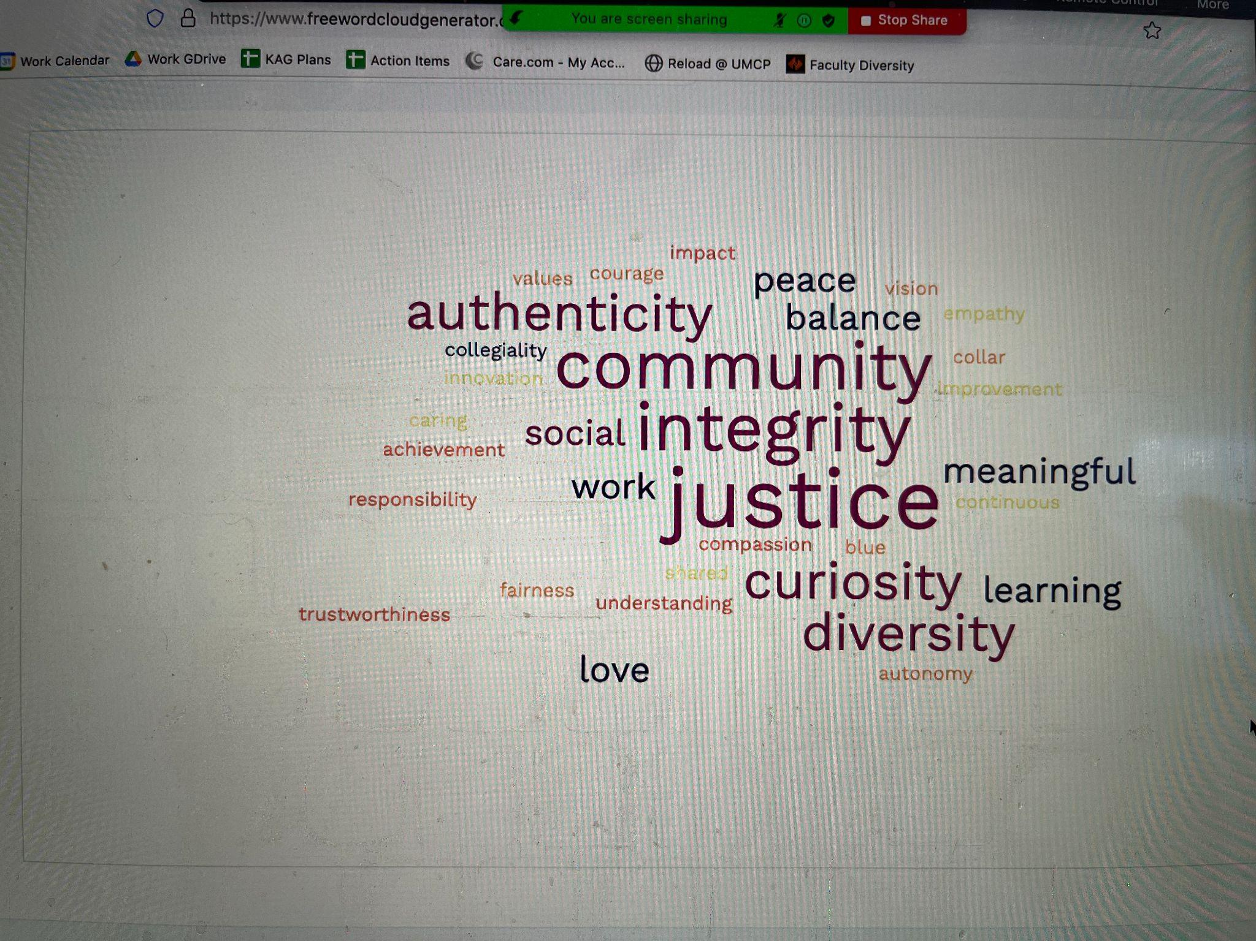
How do we use this information?
As an anchor - reconnect us to our why
As a signal - informs others about you & how you lead
As a guardrail - is an opportunity the right fit

