Slide 1

Authentic Assessment Design
Backward Design, Formative Assessment, & Rubrics
ACS Summer Workshop on Authentic Assessment
https://www.usnews.com/education/k12/articles/what-is-project-based-learning

Slide 2
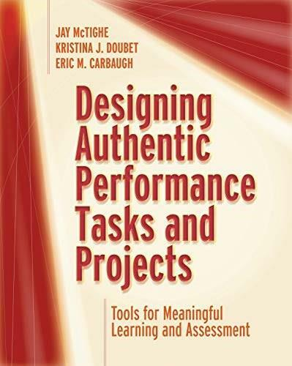
Large image slide
McTighe, J., Koubet, K. J., & Carbaugh, E. M. (2020) Designing authentic performance tasks and projects. Alexandria, VA: ASCD. ISBN: 978-1416628361.
Primary Resource
FUNKY TUNES

Slide 3
Is this someone you know?
“I’m teaching Intro next semester. Guess I should pull things together.”
1. Pick textbook with good instructor resources
2. Write down chapters/readings in order
3. Add dates for exams and papers
4. Write a few general learning objectives; “I’ll figure it out later…”
5. Teach using the publisher’s slides
6. Give periodic exams, perhaps using the publisher’s test bank
7. Assign grades
8. Do it all over again.

Slide 4

What does that class look like?
You tell me!
→ What are strengths and pitfalls of forward design and traditional instruction?
Type your response in the chat
When we have problems to solve, we work with the end in mind. Why not do this with instruction?

Slide 5
What happens with teaching & Learning?
Forward-design/traditional assessment
Backward design/authentic assessment
Content-centered
Exams
Facts
Lower-level skills (Bloom’s taxonomy)
Sage on the Stage
Emphasis on summative assessment
Learner-centered
Problem-solving
Transferable skills
Higher-level skills (Bloom’s taxonomy)
Guide on the Side
Formative & summative assessment
VS.

Slide 6
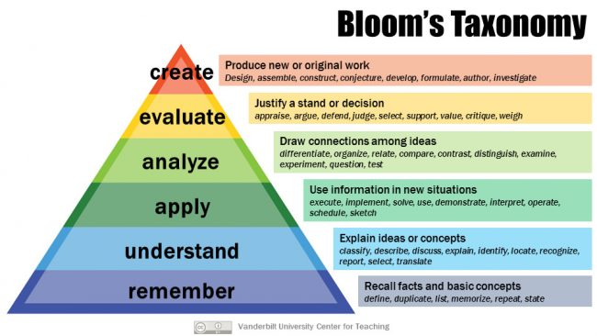
Backward Design: Alignment and Skills
Focus on skills and transferability
Content serves as context
Desired student learning objectives (SLOs) guide instructional methods, activities, and measurement
SLOs should use behavioral, measurable verbs
https://cft.vanderbilt.edu/guides-sub-pages/blooms-taxonomy/

Slide 7
Quiz time: Which is Not a measurable slo?
Identify the five characteristics of Emerging Adulthood
Critique Arnett’s theoretical presentation of Emerging Adulthood as a stage of life
Understand how Emerging Adulthood applies to your life
Develop an infographic on Emerging Adulthood for high school seniors
Type your response letter in the chat when prompted

Slide 8
Your Turn! Chat with us…
First, comment with a concept or topic that you would like your students to learn about.
Now, type out a measurable SLO in the chat.

Slide 9
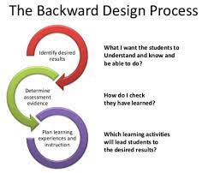
Backward Design Planning: Reverse-Engineering
Start by identifying course goals and measurable learning objectives
Figure out how you will measure student performance relevant to those objectives
Design tasks or projects that will help students practice their performance with relevant skills
Develop specific instructional activities and evaluation instruments for formative & summative assessment
https://commons.hostos.cuny.edu/edtech/2020/01/03/begin-at-the-end-and-work-backwards-in-course-design/

Slide 10
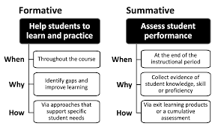
Formative and summative assessment
Assessment FOR Learning
Assessment OF Learning
https://www.celt.iastate.edu/teaching/assessment-and-evaluation/assessment-overview/

Slide 11
The Importance of Formative Assessment
Launch
Launch
Informs and guides instruction
Track students’ performance on small units that contribute to final task or project
Allows students to practice assessed knowledge, skills, & abilities
Low-stakes assessment (both for you and the students)
Supports alignment of objectives and assessment

Slide 12
Teach like a coach (McTighe et al., 2020)
1. Assess students in the beginning
2. Set the tone for success
3. Rehearse the skills of the game
4. Monitor progress
5. Provide targeted feedback to individuals and groups
6. Incorporate opportunities for scrimmage (practice)

Slide 13
Developing assessment measures: alignment
Identify criteria for assessment based on targeted learning outcomes
  Content criteria: Knowledge of facts, concepts, and principles
  Process criteria: Proficiency in a skill; effectiveness of procedures
  Quality criteria: Overall craftsmanship of a product or performance
  Impact criteria: Engagement with purpose and audience
Criteria guide development of the assessment task
Criteria support use of evaluation tools

Slide 14
Measuring Outcomes:
Criterion Performance lists
    Aka “Checklist” or “scoresheet”
    Lists criteria
    Space for feedback
    Space to record points
    Pros: Simplicity, easy to use with new tasks
    Cons: No performance descriptors, reliability can be low

Slide 15
Measuring Outcomes: Holistic Rubrics
  General criteria
  Yields overall impression of performance
  Include descriptors
  Pros: Good for simple tasks, transfer to multiple assignments, quick to use
  Cons: No detailed formative feedback, can be tricky with complex tasks or projects
Pro tip: A rubric always includes descriptors of performance at different levels of mastery
Super Pro tip: A good set of ready-made holistic rubrics can be found by searching for “AAC&U Value Rubrics”

Slide 17

Measuring Outcomes: analytic rubrics
  Detailed independent criteria
  Provide specific information about performance
  Identify important dimensions of evaluation
  Pros: Good for complex tasks, detailed feedback, can be used formatively or summatively
  Cons: Can be lengthy and time-consuming to score, may be tied to single assignment

Slide 18
 | Exceptional | Good | Average | Unsatisfactory
Identify Agency Mission | Describes agency mission and connects mission to purpose of assignment. (5) | Describes agency mission and partially connects mission to purpose of assignment. (4) | Identifies agency’s mission with minimal connection to purpose of the assignment. (3) | Poorly defines agency’s mission without connecting to purpose of the assignment. (2)
Description of Agency | Agency described in detail and set in context through use of mapping or census information. (5) | Agency described in detail but with limited mapping or census information. (4) | Agency described but not appropriately set in context. Minimal use of mapping or census information. (3) | Poor description of agency. No context provided. (2)
Role in Agency | Clearly identifies role in agency; thoroughly identifies how role advances agency’s mission. (5) | Partially identifies role in agency; role in advancing agency’s mission is adequate.(4) | Presents a vague description of role in agency; role in advancing agency’s mission is less than adequate. (3) | Poorly identifies or does not identify role in agency; gives no evidence of how role advances agency’s mission. (2)
Ethical Standards | Clearly identified and followed ethical standards established by the agency and course requirements. (5) | Adequately followed ethical standards established by the agency and course requirements.(4) | Partially followed ethical standards established by the agency and course requirements. (3) | Did not follow the ethical standards established by the agency and course requirements.(2)
Pre- service Self-Assessment | Presents a detailed assessment of hopes for the experiences and pre-service biases. (10) | Presents an adequate assessment of hopes for the experiences and pre-service biases. (8) | Partially assesses of hopes for the experiences and pre-service biases. (7) | Presents little or no of hopes for the experiences and pre-service biases. (5)
Application and Integration of Disciplines (Spelman Institutional Learning Goal 2) | Clearly connects, integrates and applies knowledge (facts, theories, etc.) from psychology and other disciplines to field setting and to one’s own participation in service-learning. (75) | Adequate in connecting, integrating and applying knowledge from psychology and other disciplines to field setting and to one’s own participation in service-learning.(65) | Significant weaknesses in connecting, integrating and applying knowledge from psychology and other disciplines to field setting and to one’s own participation in service-learning.(55) | Little or no connection, integration, and application of knowledge from psychology and other disciplines to field setting and to one’s own participation in service-learning.(45)

Slide 19
Constructing Rubrics
A. Start with 3 starter columns:
Column 1: List key criteria to be measured
Column 2: Write the qualities of an expert or top-level performance associated with the criterion
Column 3: Write the qualities of a beginner or low-level performance associated with each criterion
B. Add 1-3 columns for intermediate levels
Flesh out what distinguishes different levels of performance
Use parallel phrasing where possible
C. Assign labels and points to the different columns and criteria
D. Remember that the rubric is a living document: refine as needed.
Pro tip: Points do not need to be equivalent to the performance level. Adjust points to your grading scale (i.e. what grade would you assign for “meets expectations”?)
Super Pro tip: To engage students, you can use creative labels for the performance levels, such as Padawan, Jedi Knight, and Jedi Master.

Slide 20
Let’s Go Meta In the chat.
SLO: Design an analytic rubric
What performance criteria would indicate whether a student can design an analytic rubric?
What would expert-level performance look like for each criterion?
What would beginner-level performance look like for each criterion?
You can finish on your own as practice
Launch
Launch

Slide 21


What about tests and quizzes?
These still have a role, especially in assessing content mastery
Think of responses as single-item criterion (e.g. correct/incorrect)
Pay attention to alignment with outcomes
Consider formative as well as summative uses

Slide 22
Large image slide
McTighe, J., Koubet, K. J., & Carbaugh, E. M. (2020) Designing authentic performance tasks and projects. Alexandria, VA: ASCD. ISBN: 978-1416628361.
Primary Resource
FUNKY TUNES

Slide 23
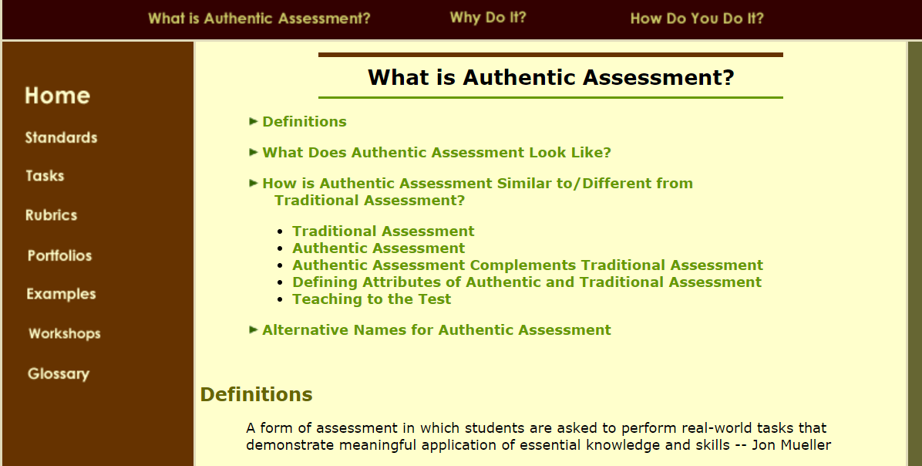
Another great resource: Jon Mueller’s Authentic Assessment Toolbox

Slide 24

Thank You
FUNKY TUNES
Launch
Launch
ACS Summer 2022
kbrakke@spelman.edu

Slide 25
Your Turn: Breakouts
Guiding Questions for Sharing and Brainstorming:
What class are you considering and what is your learning goal for the class?
What measurable objective are you thinking of?
What are some ideas and/or some challenges that you are considering right now?
Help each other work through ideas and challenges
Let everyone have a chance to share (30 min total)
Exchange contact info if you find a good assessment buddy
Launch
Launch

