Slide 1

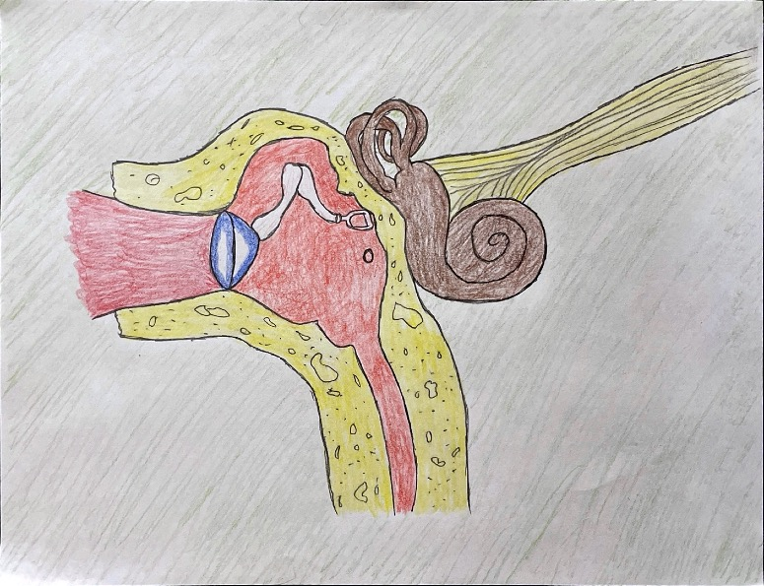
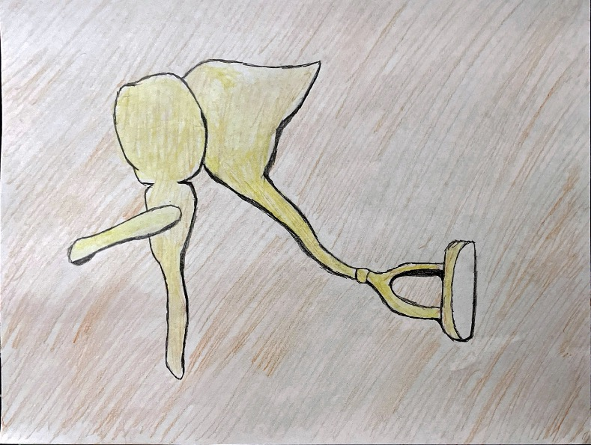
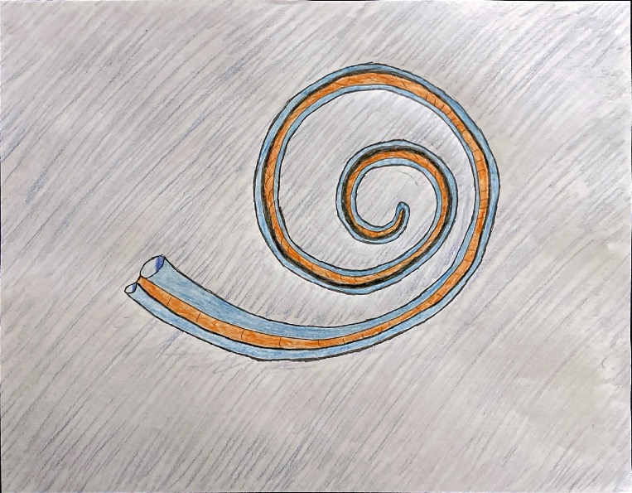
The Auditory System And Age-Related Hearing Loss
The auditory system is a biological necessity for all creatures. It is one of the senses animals use understand their environment. In humans, the auditory senses wear down and become less responsive over time. This is relative, as one’s lifestyle can have a great impact on how fast their auditory system breaks down. It is dependent on one’s occupation, daily activities, and especially potential injuries that may have severely damaged a certain organ within their auditory system. In this poster, the functions of this system, the impact of hearing loss on an individual, and the causes of hearing loss are analyzed.
Outer ear
Middle ear
Inner ear
Auditory nerve
Stapes
There are different illnesses that can cause hearing loss. In many developing countries, such as east Asian and sub-Saharan African countries, age-related hearing loss is related to preventable causes according to Davis et al. (2016). The authors also mentioned that some of these illnesses are noise-induced hearing loss, genetic hearing loss, impacted ceruman (ear wax in the outer ear), otitis media, or even sensorineural damage that could be caused from malnutrition. However, hearing loss has more severe impacts on one’s life as “language comprehension, memory, walking, and driving, and prolonged alterations in brain activation during listening may result in permanent neuroplastic changes in the brain” (Davis et al., 2016). By altering all of these functions it potentially creates more cognitive wear on one’s brain, as the brain must work harder to complete tasks. This can also lead to other more detrimental cognitive diseases as mentioned by the authors. Most importantly it will also have a social impact on the individual’s life. As mentioned before, the sense of hearing is highly significant in communication between individuals. This forces that individual with the illness to resort to more nonverbal behaviors for communication. The authors mentioned that these are all disadvantages created by the illness that leads to the development of occupational problems and participation in interpersonal relationships. For example, employers may have prejudice around the disadvantages of such applicants and by the act of discrimination, reject their application. This is the case where the applicant with age-related hearing loss is treated as an outgroup compared to the other younger applicants. The consequence of identifying such people as outgroups is ingroup favoritism. More resources are offered and are available to younger more healthier applicants compared to individuals with age-related hearing loss. Such acts are present in society because of the lack of awareness around hearing loss illness.
References
---------------------------------------------------------------------------------------------
Davis, A., McMahon, C. M., Pichora-Fuller, K. M., Russ, S.,
Lin, F., Olusanya, B. O., Chadha,
S., & Tremblay, K. L., (2016). Aging and hearing health: the life-course approach. The
Gerontologist, 56 (2), 256-267. https://doi.org/10.1093/geront/gnw033
Gazzaniga, M. S., (2018). Psychological science (S. L.
Snavely, Ed.). (6th ed.). W. W. Norton &. Company, Inc.
Sound wave
Malleus
------------------------------------------------------------------------------------------------
Base of stapes
Incus
------------------------------------------------------------------------------------
Eardrum
Figure 2. Malleus, Incus, and Stapes
As an object moves across a table, the point of contact and friction causes a vibration in that surface. A force or source of energy is required to move this object. Some of that energy input is translated into heat energy from friction and some is translated into vibrational energy. This vibrational energy can then be transferred into the air, creating areas of compressed and decompressed air with differing pressures, traveling in what we call sound waves. Relative to the source of energy, the sound waves travel with different frequencies, and amplitudes. A wave with high frequency (measured in hertz) will present a high-pitched sound, and a wave with high amplitude will present a loud sound. This is important, especially for humans, to understand another’s behavior and demeanor. Humans use their auditory receptors, as well as other senses, to recognize one’s emotional state by the detection of pitch and loudness of voice, and analyzing it in correspondence with their nonverbal behavior. Over a period of time, noise and loud sounds slowly damage specific parts of the auditory system which leads to the prevalent illness of hearing loss. According to Davis et al. (2016) hearing loss is determined using audiometric threshold, which is the detection of the softest sounds from a variety of different frequencies by an individual. The authors have also mentioned that there are significant hearing loss issues in ages above 65, however, as income increases the number of cases also decrease.
Oval window
Cochlea
------------------------------------------------------------------------------------
Apex
Round window
Base
Figure 1. The outer, middle, and inner ear
Basilar membrane
Figure 3. Cochlea interior
So, how is a wave translated into a recognizable sound? When a sound wave reaches the ear, it first starts its journey by entering the outer ear and the auditory canal as shown in figure 1. It then quickly travels to the first detection zone, the eardrums. Just like the batter head of a drum (the region where drum sticks are used to make sound), the eardrum vibrates relative to the amount of energy it receives from the sound wave. Connected to the eardrum, are a chain of three small bones called malleus, incus, and stapes making up the middle ear, as shown in figure 1. These bones are called the ossicles. Since they are directly connected to the eardrum, they are able to receive its vibrations. The vibration first goes through malleus, then incus, and lastly stapes (figure 2). As they vibrate according to the vibrations of the eardrum, the base of stapes directly transfers the vibrations to a membrane window called the oval window. This is the start of the inner ear. The membrane window then creates pressure waves inside the cochlea, where the auditory receptors lie. As pressure enters the cochlea, it also must be relieved or the membrane inside the cochlea would get damaged. In order to fix this issue, another membrane window is located next to the oval window, called the round window. The pressure waves from the oval window cause the basilar membrane to oscillate which then causes the hair cells to bend and move in certain ways. These movements are the point at which waves are translated into cellular signals. In order to recognize and individualize high and low frequencies, separate mechanisms called temporal coding and place coding are used. Temporal coding detects low frequency sounds. According to Gazzaniga (2018), for the detection of low frequency waves the hair cells are able to match their firing rate with the frequency of the sound. This matching happens only “up to about 4000 Hz” (Gazzaniga, 2018). Place coding however is a mechanism that uses the placement of hair cells for detecting higher frequencies; at different regions within the cochlea, the hair cells are able to detect different frequencies of sound. Gazzaniga (2018) described that the higher frequencies are detected at the base of the cochlea and the lower frequencies at the tip/apex, as shown in figure 3. Once the hair cells have moved according to the oscillations of the basilar membrane, their movements are then translated into signals, which then travel to the primary auditory cortex by way of auditory nerves. The hair cells can’t identify where the wave is coming from, or what object is making that sound. These perceptions are all detected and analyzed within the auditory cortex. Gazzaniga (2018) has mentioned how our auditory system works very similarly to how owls detect the placement of a sound. We are able to locate sound by detecting the arrival time of the wave to each ear and its intensity, as the head is a barrier for the wave to reach the other side. By knowing the anatomy of the auditory system, hearing loss illnesses can be better understood.
Reference for the photos used for the figures
Figure 1 - https://www.exploringnature.org/db/view/stapes
Figure 2 - https://simple.wikipedia.org/wiki/Ossicles
Figure 3- https://www.britannica.com/science/ear/Transmission-of-soun d-within-the-inner-ear

