Slide 1
Sample GPR output
Shaker Village Cemetery, Kentucky

Slide 2
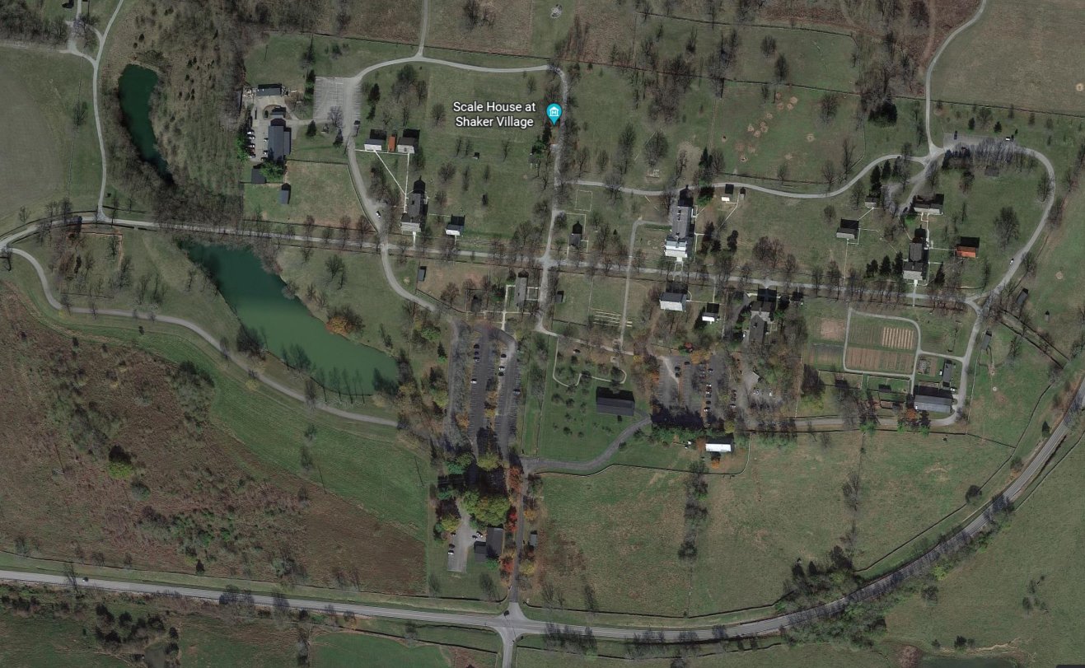
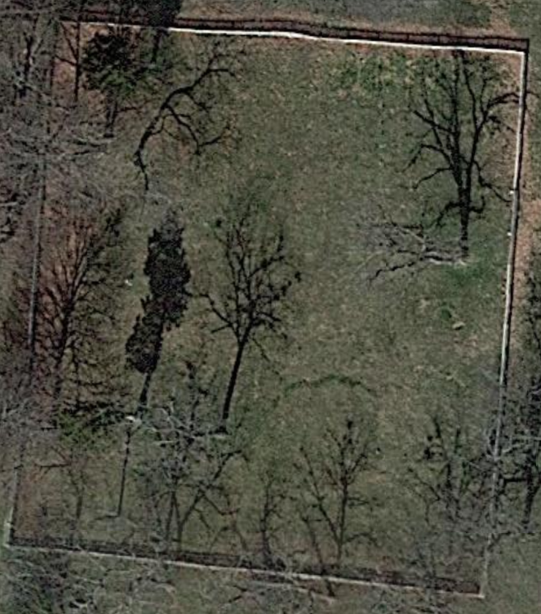
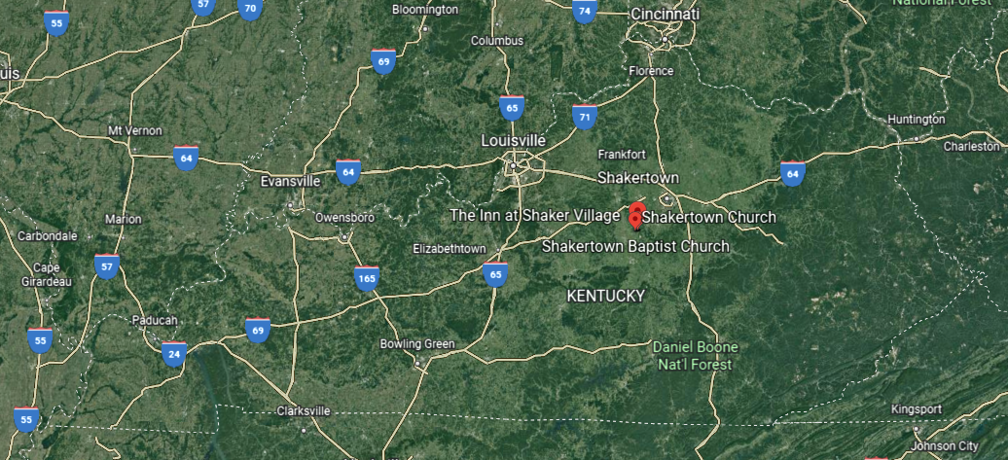
Location
Cemetery
Historic village
Survey area

Slide 3
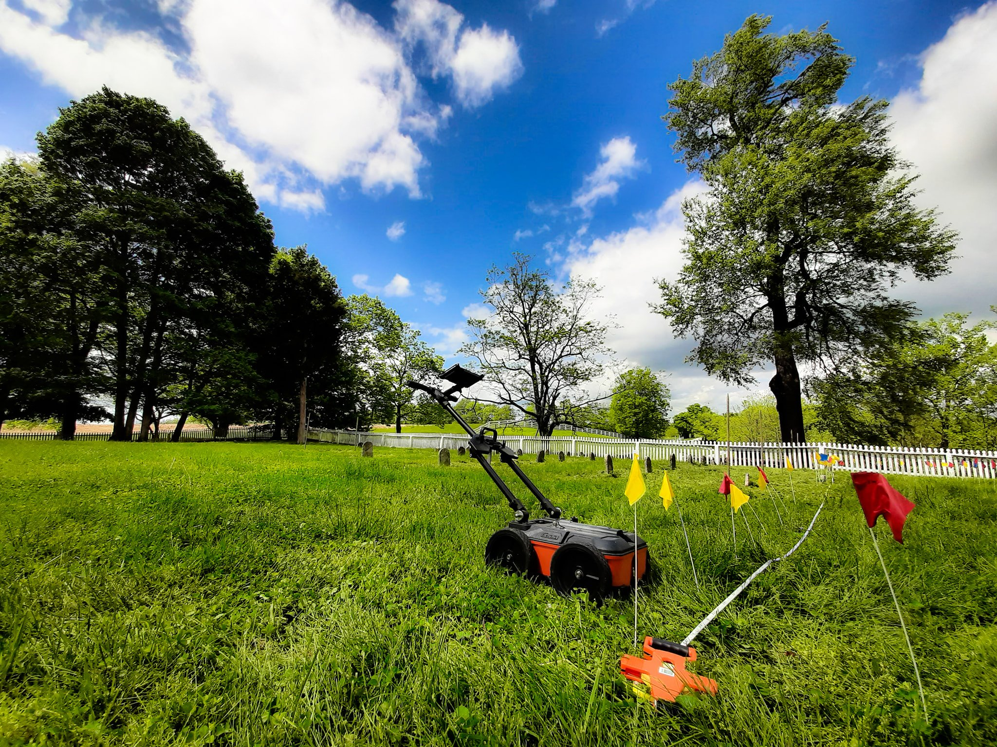
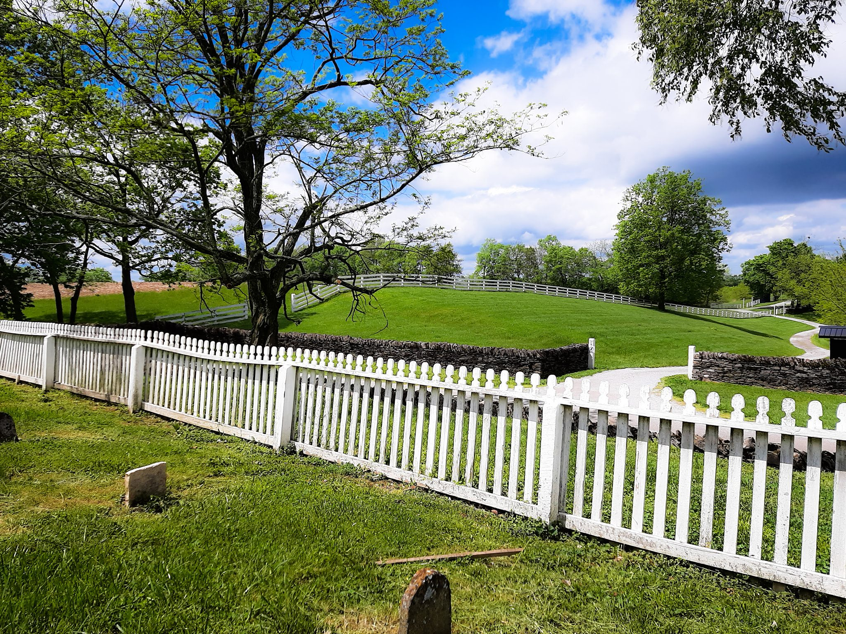
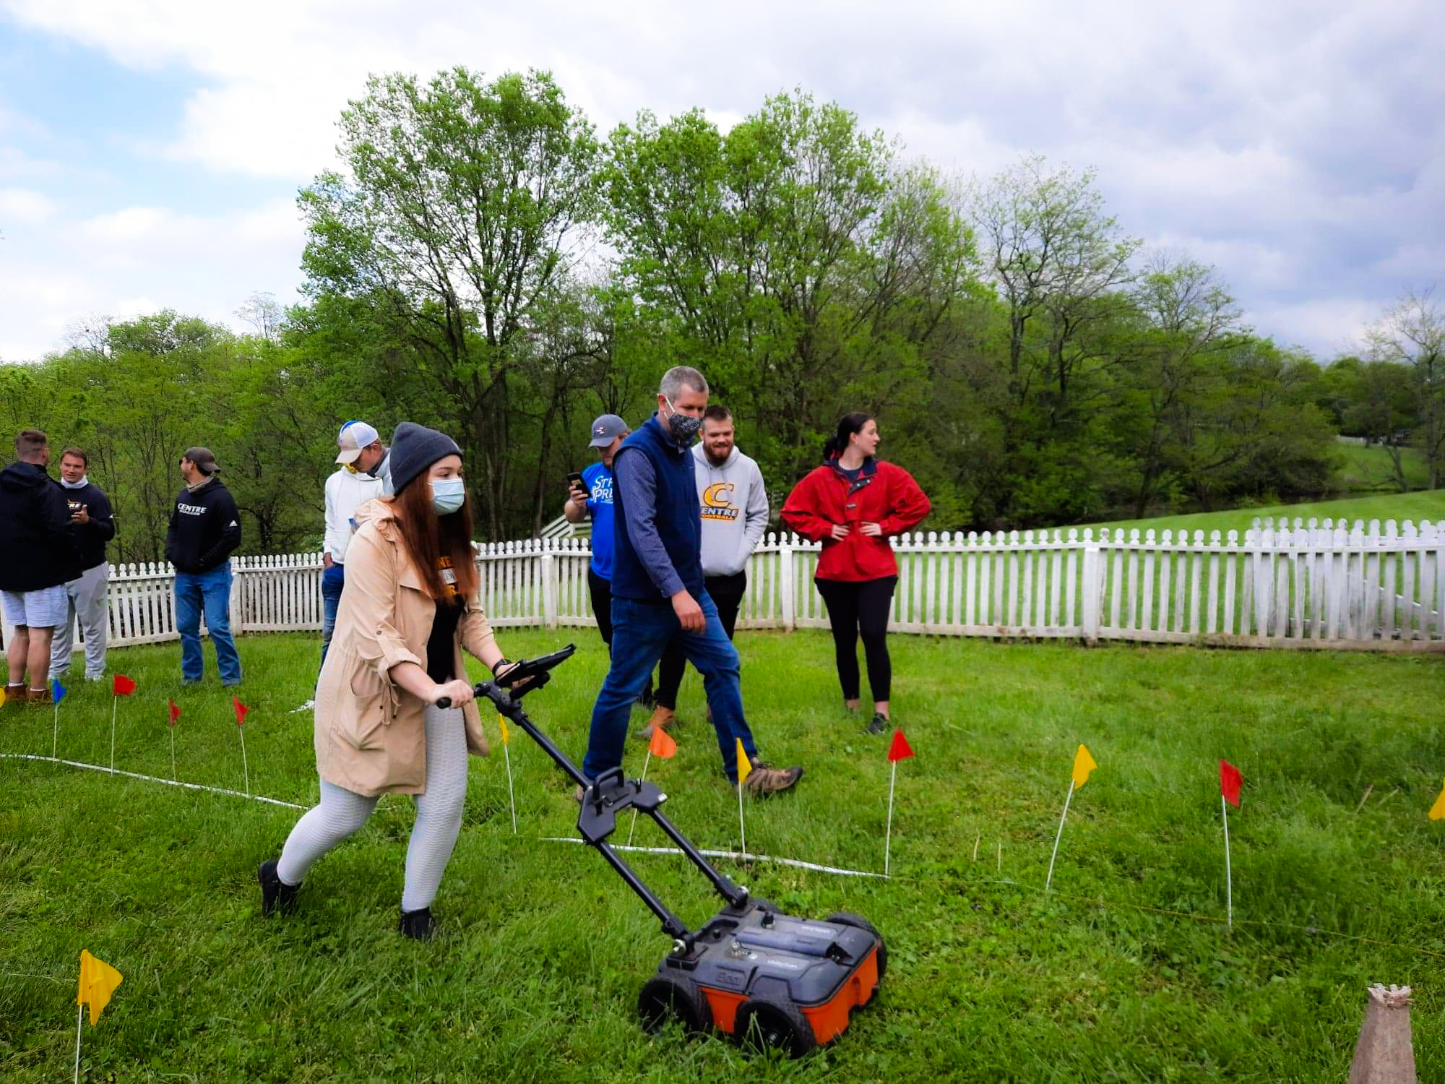
Data Collection
Spring 2021

Slide 4
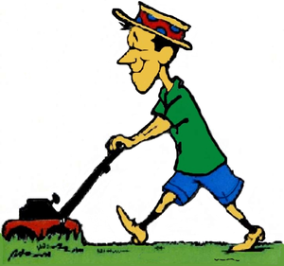

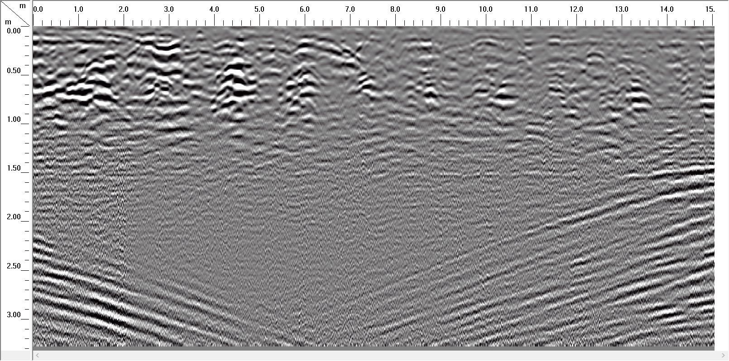
Example of time slice with approximate headstone locations marked
Distance
Depth
Facing east

Slide 5
For instructors:
Interpretation – GPR reflection in this location is likely detecting cuts into clay-capped rocky soil where the burials themselves are not detected, but the removal of rocks in burial cuts is. Stress to students that where headstones are located might be approximate and double burials (one headstone for a married couple) could be present.
continued

Slide 6
The GPR reveals regular intervals of cuts that are anomaly scored in the 1-3 range. Dark areas likely represent limestone rock and the lack of defined coffins could be due to clay soil conditions. Despite four headstones, there are possibly 10 burials, Headstone 1 is inconclusive and headstone 2 could be in the center of a double burial. Ground-truthing the upper part of a grave shaft would provide more data for future interpretation.
3?
1
1
1
1
1
1
1
1
1
Facing east

