Slide 1
Making Learner-Centered and Inclusive Pedagogical Choices for an Unpredictable Fall Term
ACS Summer Workshops on Advancing Pandemic Pedagogies
Monday, June 29, 2020 • 10:00-11:30 am EDT (9:00-10:30 am CDT)

Slide 2
Introductions & Information
Facilitators:
• Kent Andersen • Birmingham-Southern College
English & Director of Leadership Programs
• Barbara Lom • Davidson College
Biology & Neuroscience
• Kerry Paumi • Centre College
Chemistry & Chief Health Professions Advisor
• Betsy Sandlin • Sewanee: The University of the South
Spanish & Associate Dean for Inclusion and Faculty Development
Slides + Appendix of Resources:
• will be sent after the event

Slide 3
Welcome
• Recording
• Mute when not speaking
• Breakout groups, chat, browser (Mentimeter/padlet)
• Respectful dialog

Slide 4
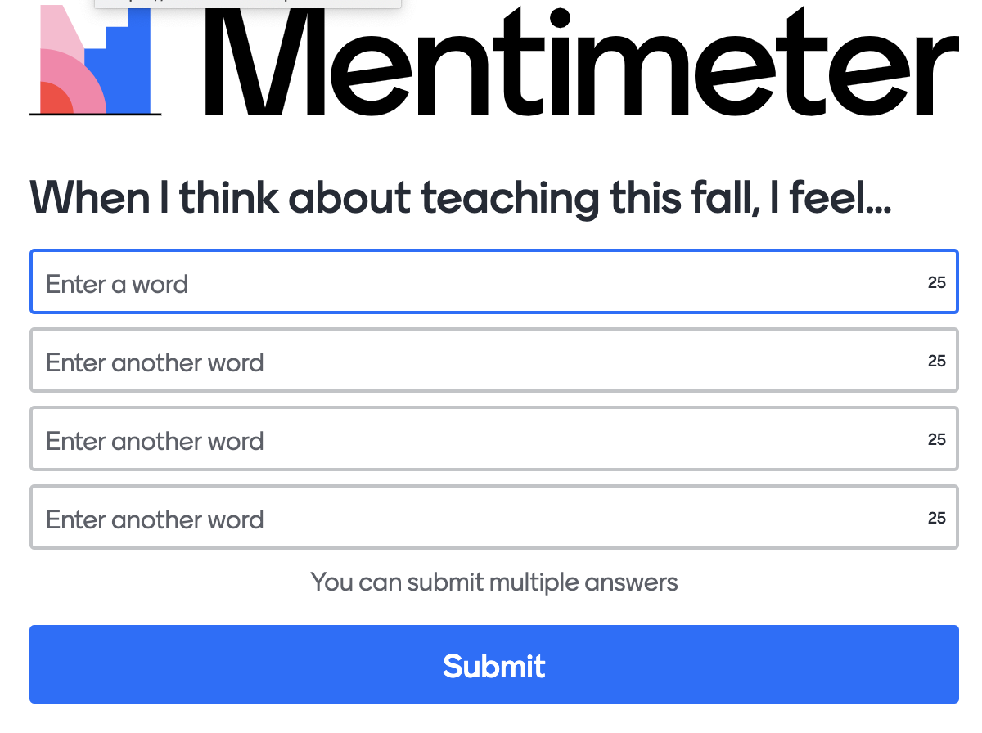
When I think about teaching this fall, I feel __________________________.
Checking In
→→Fill in the blank with a word/short phrase
www.menti.com/beay6en23j

Slide 5
When I think about teaching this fall, I feel __________________________.
Checking In

Slide 6
Notes:
KENT

Slide 7
Plan for Today
Identify contextual complexity
Reframe pedagogical challenges for new solutions
Apply principles of inclusive and learner-centered teaching
Reflect on your own teaching situation
Identify choices you can make
Increase your sense of autonomy and confidence
+

Slide 8
Complexity
Known
simple
complicated
Disordered
Ordered
complex
chaotic
Unknown
Snowden & Boone (2007)

Slide 9
Professor D’s Challenge
My biggest unsolved challenge this spring was Zoom discussions. The tactics I would normally employ in a discussion class just did not work online. Students were reluctant to participate – they neither asked questions on their own nor answered the questions I posed.
What is the complexity of Professor D’s challenge?
→→enter one option below in the chat:
simple (or *simple)
complicated (or *complicated)
complex (or *complex)
chaotic (or *chaotic)
* indicates you are unavailable to elaborate
2% = simple
71% = complicated
27% = complex
0% = chaotic
40% of responses used *

Slide 10
Reframing

Slide 11
Frames Shape Responses
We develop default interpretations
→→ What assumptions do we make when we ask how to plan a party for David?
“How should we plan this birthday party for David?”
“How can we create a special day David will enjoy?”
reframing
(Thanks to Ben Haywood & Diane Boyd at Furman for this example)

Slide 12
Frames Shape Responses
→→ What assumptions do we make when we ask how to plan a party for David?
David want's a party
Dave wants a party.
That David likes parties
David wants and is OK with a party
David is an extrovert
David wants a birthday party
*That David would enjoy
*David wants a party
That David will have a party
*that david wants a party
* birthday = party
Dave wants a party
Assumption that David wants a party
Assumes a party is the thing David will enjoy
A formulaic pattern to repeat
There’s a right way to do it
David wants a party
David wants a party
That David wants a party
assume he likes parties
birthdays require parties and everybody loves parties
david wants a party
Assuming that a party is something David wants
That David wants a party
That a party is the go-to choice
David enjoys celebrating his aging!
david likes parties
*that a party is the only way to celebrate someone
David would like to have a party
David wants a party with us
we want to celebrate
positive, creative
The assumption is that we have to plan this instead of asking David what he wants
David likes parties, birthday parties are fun
birthday=party
*David wants party
The party is the important factor -
How well do I/we know David?
David wants a party and will come.
He wants a party
that David even wants a party
*That David wants aparty
David would enjoy an event with lots of people rather than an activity.
That David wants a b’day party!
He wants US to plan the Birthday party
A party is possible
That David wants us to plan
doing good thing
That we are going to decide how David will enjoy his birthday with a party
*David wants to party • do we know David?

Slide 13
Reframing & Problem Solving
“The elevator is too slow.”
reframing
“The wait is too long.”
problem solving
problem solving
Make the elevator move faster
• upgrade motor
• improve algorithm
• install more elevators
Make the wait feel shorter
• play music
• install a television
• provide hand sanitizer
(Thanks to Ben Haywood & Diane Boyd at Furman for this example)

Slide 14
Reframing & Problem Solving
“What should I say in my speech?”
“What does my audience need to hear?”
reframing
problem solving
problem solving
Generate a list of topics
• how to cover all the content
• consider content by others
• satisfy ‘supposed’ best speech
Generate a list of audience needs
• think about audience situation
• fit your expertise to audience
• meet needs of situation
(Thanks to Janet Eyler at Vanderbilt for this example)

Slide 15
Professor D’s Challenge
My biggest unsolved challenge this spring was Zoom discussions. The tactics I would normally employ in a discussion class did not work online. Students were reluctant to participate – they neither asked questions on their own nor answered the questions I posed.
Help Professor D think differently for fall:
What is really at issue? (How to reframe?)
What possible solutions does reframing reveal?
→→ Reframe together to generate solutions

Slide 16
Inclusive Teaching

Slide 17
Inclusive Teaching
Communicate and design intentionally
• provide clear and transparent structures, explicit expectations (+support)
• design with accessibility in mind, multiple means of engagement
Select content inclusively
• recognize diversity and barriers to inclusion
• foster opportunities for connecting content to learners’ interests and lives
Create a climate that signals belonging
• all voices welcomed and empowered to contribute
• learning environment emphasizes growth, not perfection
Examine policies and practices
• audit images/sources for inclusion
• check for alignment between learning objectives and policies
Reflect continually
• work to expand awareness of student experiences, best practices, and self
• adopt mindset of inclusion as life-long process

Slide 18
Inclusive Teaching
Which dimension(s) of inclusivity are relevant for professor D’s challenge?
→→ Type the letter(s) in the chat
A. Communicate and design intentionally
B. Select content inclusively
C. Create a climate that signals belonging
D. Examine policies and practices
E. Reflect continually
A = 47 votes
B = 17 votes
C = 54 votes
D = 37 votes
E = 17 votes

Slide 19
Inclusive Teaching
When you teach inclusively, students think/feel: I belong here, I can learn this, I find this meaningful. Peter Felten
What inclusive teaching ideally does is foster an environment where students feel like what they bring to the class is an asset, not a limitation. Jenae Cohn
Inclusive pedagogies turn the focus of the experience on the student, the uniqueness of their contexts…to extract excellence from them. Bryan Dewsbury
Inclusive instructors: reduce barriers, increase opportunities for their students, and recognize classrooms are inherently social spaces. Luis Rivera

Slide 20
Learner-Centered Teaching

Slide 21
Learner-Centered Teaching
Instructor facilitator of learning
(not source of knowledge)
Power shared - at a level appropriate for students
(not unilaterally controlled by the teacher)
Content a resource for solving problems and learning
(not as material to be “covered” and tested)
Learning students and instructors are mutually responsible
(not independent of each other)
Evaluation forward-looking; feedback emphasizes learning/growth
(not backward-looking, not competitive, not rankings)
Maryellen Weimer (2013), Learner-Centered Teaching. San Francisco, Jossey-Bass

Slide 22
Learner-Centered Teaching
How many of these lenses might be relevant for reframing Professor D’s situation? →→ Pick one and briefly explain why in the chat.
Instructor facilitator of learning
Power shared - at a level appropriate for students
Content a resource for solving problems and learning
Learning students and instructors are mutually responsible
Evaluation forward-looking; feedback emphasizes learning/growth

Slide 23
Learner-Centered Teaching
How many of these lenses might be relevant for reframing Professor D’s situation? →→ Pick one and briefly explain why in the chat.
Instructor facilitator of learning
Power shared - at a level appropriate for students
Content a resource for solving problems and learning
Learning students and instructors are mutually responsible
Evaluation forward-looking; feedback emphasizes learning/growth

Slide 24
Learner-Centered Teaching
How many of these lenses might be relevant for reframing Professor D’s situation? →→ Pick one and briefly explain why in the chat.
students need to have a sense of ownership
learning - if students expect to passively receive knowledge (like in the Matrix), they have no reason to engage
Power - have students lead discussion
Learning - mutual responsible - help the students recognize that they have agency and ownership over their learning
Power -- who seems in charge of the discussion
Power and Content
Power-Professor D can offer different ways to engage (not just discussion participation) given that the students may be facing different, complex situations
Learning, because lack of response probably means no investment/responsibility for the course in this sense
Facilitator of Learning: Students learn as much from each other during discussion as from the prof
*Learning
Power: Students feeling empowered to lead discussion and/or suggest alternate modes of online engagement
Power: rather than think about discussion as they answer my questions (or I answer theirs), think about how we can have convo together
Power - offer the students a selection of appropriate topics, student choose the discussion topic
*Power: esp when moving online, let students help develop new course discussion guidelines that make the situation comfortable
evaluation - it is unclear how he provides feedback for the discussion and, similarly, how he motivates the students and focuses on growth and learning
Learning - students and instructors are mutually responsible for participating in the discussion - make it clear they have a responsibility for participating
Shifting power dynamic/empowering students to own class time and success
discussion coming from him rather than students
Power, sharing the leading of the discussion and its format after asking students what other formats work better for them
power and learning
content - let students decide
In terms of learning - didn’t create an atmosphere where students felt mutually responsible for learning
Student feedback is CRITICAL
*Evaluation: forward-looking - being in Zoom discussions will not really be conducive to the class discussions he is used to
power, if students are intimidated about his potential response, they might be reluctant to participate

Slide 25
Learner-Centered Teaching
How many of these lenses might be relevant for reframing Professor D’s situation? →→ Pick one and briefly explain why in the chat.
facilitator of learning: have students provide input on what expectations should be in a Zoom discussion - or if there are other ways to participate
power, content and learning.
content: how does the topic relate to students’ lives and the world today?
power content evaluation
learning; students may be expecting the instructor to do all the work
Power - you need to put more power to lead the conversation into the hands of the students.
power- students have input as to whether discussion are the method they want to learn through
Power-it appears that the Professor feels they should be the center of directing the discussion as opposed to having the students drive their own discussion around their perspective and insight
reframe the role of the instructor -- not sage on stage, but facilitator (feeds into mutual responsibility also)
Instructor and content as well
*power - ask students how they might frame discussions to be deeper/richer?
*Learning
Power share the inputs to discussion questions. What do we need to think about to address the problem?
Power - What ways do students find most effective for their engagement?
power—students are not aware of their role in the learning process, may feel that their discussion is not really relevant
power: how is it part of their “reluctance,” might they feel less empowered than in class/
Power - have individual as well as group accountability and have students help determine what that looks like.
*Learning - sharing, developing together
power-
evaluation: encourage reticent students to try participating by taking small steps
Content, creating more resources for students who might not understand the issue or need other methods/forms to help them understand the topic and have more to contribute

Slide 26
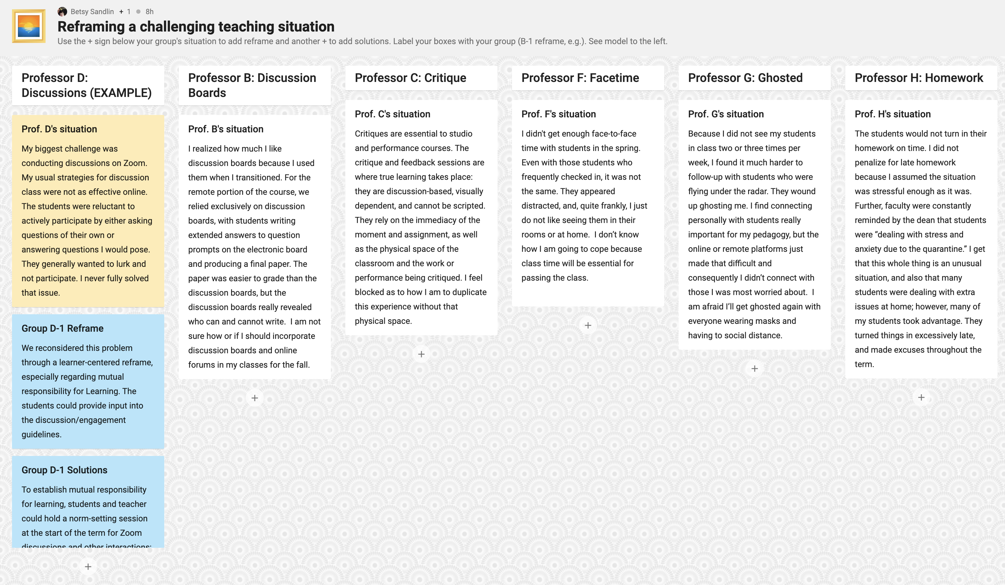
Teaching Challenge Cases
Task: Reframe & Develop Solutions
→→ How might you reframe?
→→ What solutions present themselves?
https://padlet.com/bsandlin1/acsworkshop

Slide 27
Reflecting on Your Challenges
Think of one specific challenge you are facing for Fall 2020
→→ Briefly write down (for yourself):
A. your specific challenge
B. how you can begin to reframe your challenge
C. new solution(s) revealed by reframing
A.
B.
C.

Slide 28
Reflecting on Your Challenge
→→ Can inclusive and/or learner-centered teaching principles help you reframe your challenge?
83% = yes
17% = possibly
0% = no

Slide 29
Summary
Reframe
Include learners
Reflect
Don’t go it alone
+
→→ You’ve got this

Slide 30
Thank You
kanderse@bsc.edu
balom@davidson.edu
kerry.paumi@centre.edu
bsandlin@sewanee.edu
Slides + appendix of resources will be sent after the event

Slide 31
Appendix
Challenge Complexity
Reframing Resources
Inclusive Teaching Resources
Learner-Centered Teaching Principles and Design
Learner-Centered Teaching Resources

Slide 32
Challenge Complexity
Snowden & Boone (2007) A leader’s framework for decision making. Harvard Business Review
Simple
categorize
known knowns
repeating patterns
cause/effect
= clear
a right answer
exists
Complicated
analyze
known unknowns
expert diagnosis
cause/effect
= discoverable
more than one right
answer possible
Complex
probe
unknown unknowns
flux + unpredictability
cause/effect
= emergent
many competing
ideas
Chaotic
act
unknowables
high turbulence
cause/effect
= undeterminable
many decisions; no time to think

Slide 33
Challenge Complexity
Snowden & Boone (2007) A leader’s framework for decision making. Harvard Business Review
Cynefin /ku-nev-in/ framework
consider new viewpoints
assimilate complex concepts
address problems and opportunities
rapidly understand context
acknowledge irrationality and unpredictability

Slide 34
Inclusive Teaching Resources
WEB RESOURCES: • Columbia CTL (n.d.) Guide for Inclusive Teaching at Columbia
• CRLT (2014) Inclusive Teaching Framework & Strategies
• Sandlin (2019) Starting Point: On a Path Toward More Inclusive Teaching
• Sathy & Hogan (2019) Want to Reach All of Your Students? Here’s How to Make Your Teaching More Inclusive
BOOKS:
• Eyler (2018) How Humans Learn: The science and stories behind effective college teaching
• Lang (2016) Small Teaching: Everyday lessons from the science of learning
• Ross (2016) Breakthrough Strategies: Classroom-based practices to support new majority college students
• Verschelden (2017) Bandwidth Recovery: Helping students reclaim cognitive resources lost to poverty, racism, and social…
PODCASTS:
• Hidden Curriculum (social context of student experiences)
• Tea for Teaching (a podcast on teaching and learning)
• Teaching in Higher Ed (faculty development for professors)
ONLINE COURSES:
• EdX An Introduction to Evidence-Based Undergraduate STEM Teaching
• EdX Teaching & Learning in the Diverse Classroom
• EdX Inclusive Teaching: Supporting All Students in the College Classroom

Slide 35
Reframing Resources
• Bolman, L. G. & Deal, T. E. (2014) How great leaders think: The art of reframing. San Francisco, CA: Jossey-Bass.
• Heifetz, R., Grashow, A. & Linsky, M. (2009) The practice of adaptive leadership: Tools and tactics for changing your organization and the world. Boston, MA: Harvard Business Review Press.
• Schein, E. H. & Schein, P. A. (2019) The corporate culture survival guide: Culture, change, leadership. 3rd ed. Hoboken, NJ: Wiley and Sons.

Slide 36
Learner-Centered Teaching Principles & Design
Key Changes to Practice | Principles
Role of the Teacher teacher serves as facilitator of learning (not the source of knowledge) | Teachers let students do more learning tasks Teachers do less telling so that students can do more discovering Teachers do instructional design work more carefully Faculty more explicitly model how experts learn Faculty encourage students to learn from and with each other Faculty and students work to create climates for learning Faculty use evaluation to promote learning (forward-looking rather than backward looking feedback)
Balance of Power power is shared with students depending on their level of readiness (not unilaterally controlled by teacher) | Students provide input about course activities and assignments Students have flexibility in how to fulfill assignments Students provide input regarding course content Students provide input on course policies Students provide input regarding assessment
Function of Content content is a resource for solving problems and completing authentic learning tasks (not as material to be “covered”) | Content is used to build knowledge base by • letting students do the work as it is done in the discipline • recognizing the messiness of learning • using content to address real-world problems • helping students develop organizing schemes and moves similar to those of the expert Content is used to develop learning skills by • providing explicit instruction in learning skills, such as time-management, note-taking, reading, summarizing, • reflecting on the learning tasks so as to amplify and reinforce what students are discovering about learning about themselves as learners
Responsibility for Learning students and teachers are mutually responsible for learning (not independent of each other) | Faculty provide increasing opportunities for students to be autonomous learners Faculty let students experience the consequences of their decisions about learning Faculty act predictably and consistently in relations with students Faculty set high standards and believe their students can reach those standards Faculty signal that they care about students (e.g., by using personal examples and humor, calling students by name, conversing informally with students) Faculty take a leadership role in creating and maintain a classroom climate that promotes learning
Purpose & Process of Evaluation feedback and evaluation emphasize learning and growth (not competition and ranking) | Faculty emphasize learning over grades by • harnessing the power of grades to motivate students • reducing the stress associated with evaluation • use evaluation only to assess learning • providing multiple opportunities for students to learn from mistakes and demonstrate mastery • provide frequent formative feedback to focus students on the feedback, not the grade • provide opportunities for students to assess their own work and the work of others • develop students’ “appraisal expertise” by sharing the assessment criteria used by experts
Sources: Weimer, 2013; Blumberg, 2009; Blumberg, 2015

Slide 37
Learner-Centered Teaching Resources
Baxter Magolda, Marcia B. (1999) Learning-centered practice is harder than it looks. About Campus 4(4), 2-4.
Blumberg, Phyllis (2009) Developing learner-centered teaching: A practical guide for faculty. San Francisco: Jossey-Bass.
Doyle, Terry (2008) Helping students learn in a learner-centered environment. Sterling, VA: Stylus.
Fink, L. Dee (2013) Creating significant learning experiences: An integrated approach to designing college courses. San Francisco: Jossey-Bass.
Tagg, John (2019) The instruction myth: Why higher education is hard to change, and how to change it. New Brunswick, JN: Rutgers University Press.
Weimer, Maryellen (2013) Learner-centered teaching: Five key changes to practice. 2nd edition. San Francisco: Jossey-Bass.

